Slide 1
RDF Schema – Syntax and Intuition
Werner Nutt

Slide 2
Acknowledgment
These slides are based on slide sets by Mariano Rodriguez and Sebastian Rudolph

Slide 3
Motivation
Classes and Class Hierarchies
Properties and Property Hierarchies
Property Restrictions
Open Containers
Additional Information in RDFS
Simple Ontologies

Slide 4
Motivation
Classes and Class Hierarchies
Properties and Property Hierarchies
Property Restrictions
Open Containers
Additional Information in RDFS
Simple Ontologies

Slide 5
Schema Knowledge with RDFS
RDF provides a universal possibility to encode
data about facts on the Web
= Propositions about single resources (individuals), e.g. books
and their relationships
Desirable: propositions about generic sets of individuals (classes), e.g. publishers, organizations, persons etc.
http://example.org/SemanticWeb
ex:publishedBy
http://springer.com/publisher

Slide 6
Schema Knowledge with RDFS/2
Also desirable: specification of logical interdependencies
between individuals, classes and relationships, e.g.
  “Publishers are Organizations.”
  “Only persons write books.”
This would allow one to capture more of the semantics of the describe domain
In a database, we would collect such information in the “schema”

Slide 7
Schema Knowledge with RDFS/3
RDF Schema (RDFS):
part of the W3C Recommendation of RDF
allows for specifying schematic (also: terminological) knowledge
uses dedicated RDF vocabulary
(thus: every RDFS document is an RDF document)
name space (usually abbreviated with rdfs):
http://www.w3.org/2000/01/rdf-schema#

Slide 8
RDF Schema (RDFS)
Vocabulary not domain-specific (like, e.g., with FOAF),
but generic
Allows for specifying (parts of) the semantics of arbitrary RDF vocabularies (could thus be called a “meta vocabulary”)
Every RDFS-compliant software faithfully supports every vocabulary that has been defined through RDFS
→ RDFS is a language for lightweight ontologies
“A little semantics goes a long way.” (Jim Hendler)

Slide 9
Motivation
Classes and Class Hierarchies
Properties and Property Hierarchies
Property Restrictions
Open Containers
Additional Information in RDFS
Simple Ontologies

Slide 10
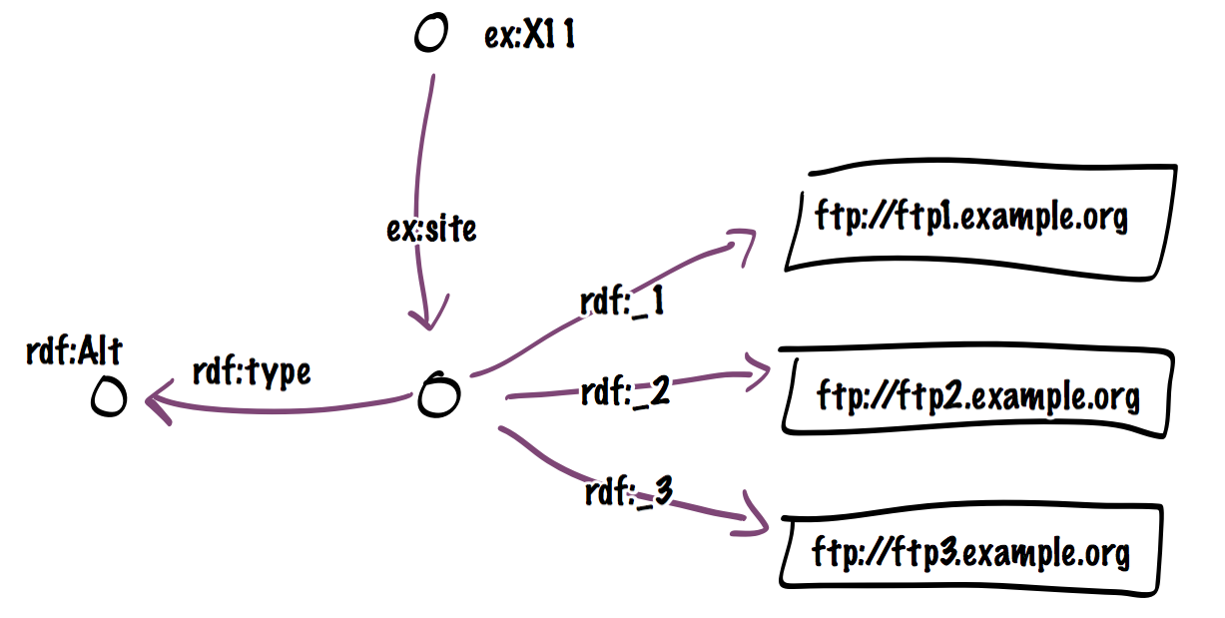
Classes and Instances
We have seen “typing” of resources in RDF when we discussed containers:
The predicate rdf:type
  endows the subject
  with the type denoted by the object
Or, equivalently,
  the subject is a member/instance of the class denoted by the subject

Slide 11
Classes and Instances/2
The triple
ex:SemanticWeb rdf:type ex:Textbook .
characterizes “Foundations of Semantic Web Technologies” as an instance of the (newly defined) class “Textbook”.
A resource can be member of more than one class,
e.g. together with the above triple we may have:
ex:SemanticWeb rdf:type ex:Entertaining .
In general, individual and class names cannot be distinguished syntactically;
this distinction is also difficult in reality, e.g. for
http://www.un.org/#URI

Slide 12
The Class of all Classes
One can also explicitly state that a URI denotes a class:
a URI can be “typed” as class
ex:Textbook rdf:type rdfs:Class .
rdfs:Class is the “class of all classes”
➔ rdfs:Class is a member of itself
➔ the triple
rdfs:Class rdf:type rdfs:Class .
is virtually present in every dataset that employs the
RDFS vocabulary (according to the RDFS semantics)

Slide 13
Subclasses – Motivation
Suppose,
our dataset contains ex:SemanticWeb rdf:type ex:Textbook .
we are searching for instances of the class ex:Book
Result?
Solution Attempt 1:
add the triple ex:SemanticWeb rdf:type ex:Book .
➔ what happens if another ex:Textbook shows up?
Solution Attempt 2:
whenever a triple b rdf:type ex:Textbook . is inserted
automatically add the triple b rdf:type ex:Book .

Slide 14
Subclasses
Solution Attempt 3:
introduce a statement saying that
“every textbook is a book”
that is, every instance of ex:Textbook
is also an instance of ex:Book
This kind of statement can be expressed with the
rdfs:subClassOf property:
ex:Textbook rdfs:subClassOf ex:Book .
means
“The class of all textbooks is a subclass of the class of all books.”

Slide 15
rdfs:subClassOf
is a property
is reflexive, thus
  ex:Textbook rdfs:subClassOf ex:Textbook
can be used to enforce that two URIs refer to the same class
ex:Haven rdfs:subClassOf ex:Port .
ex:Port rdfs:subClassOf ex:Haven .
by declaring them subclasses of each other.

Slide 16
Class Hierarchies
Subclass relationships usually come in groups:
- class hierarchies (taxonomies)
E.g.,
ex:Textbook rdfs:subClassOf ex:Book .
ex:Book rdfs:subClassOf ex:PrintMedium .
ex:Journal rdfs:subClassOf ex:PrintMedium .
RDFS semantics:
- the rdfs:subClassOf property is transitive
E.g., it follows from the above that
ex:Textbook rdfs:subClassOf ex:PrintMedium .

Slide 17
Class Hierarchies/2
Class hierarchies are often used for modeling,
e.g. in biology (Linnaean classification of living beings)
Example: zoological categorization of the modern human
<rdf:RDF xmlns:rdf="http://www.w3.org/1999/02/22-rdf-syntax-ns#"
xmlns:rdfs="http://www.w3.org/2000/01/rdf-schema#"
xmlns:ex=http://www.semantic-web-grundlagen.de/Beispiele#>
<rdfs:Class rdf:about="&ex;Animalia"/>
<rdfs:Class rdf:about="&ex;Chordata”>
<rdfs:subClassOf rdfs:resource="&ex;Animalia"/>
</rdfs:Class>
<rdfs:Class rdf:about="&ex;Mammalia”>
<rdfs:subClassOf rdfs:resource="&ex;Chordata"/>
</rdfs:Class>
<rdfs:Class rdf:about="&ex;Primates”>
<rdfs:subClassOf rdfs:resource="&ex;Mammalia"/>
</rdfs:Class>
<rdfs:Class rdf:about="&ex;Hominidae”>
<rdfs:subClassOf rdfs:resource="&ex;Primates"/>
</rdfs:Class>
...

Slide 18
Classes
Intuitively, classes correspond to sets in set theory
rdf:type corresponds to ∈
rdfs:subClassOf corresponds to ⊆
This motivates
reflexivity and transitivity of rdfs:subClassOf …
and more inferences that we will see later on
However, as we will also see, the semantics of RDFS is much weaker than set theory
(otherwise inferences would be too difficult)

Slide 19
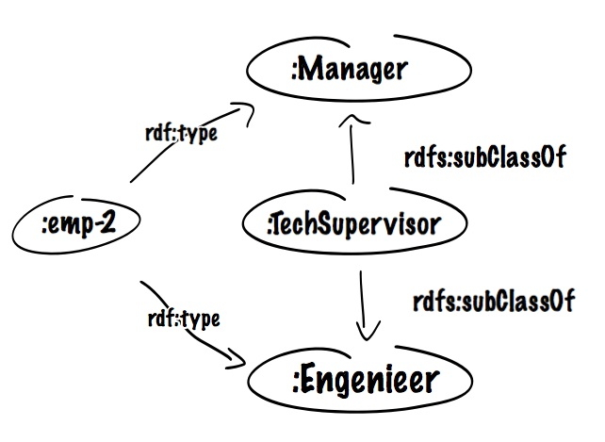
Set “intersection”
Proper set intersection is not possible in RDFS
However, expressing necessary membership to multiple classes is possible, i.e., A subset B AND C
A rdfs:subClassOf B
A rdfs:subClassOf C
consider
x rdf:type A
One direction only!

Slide 20
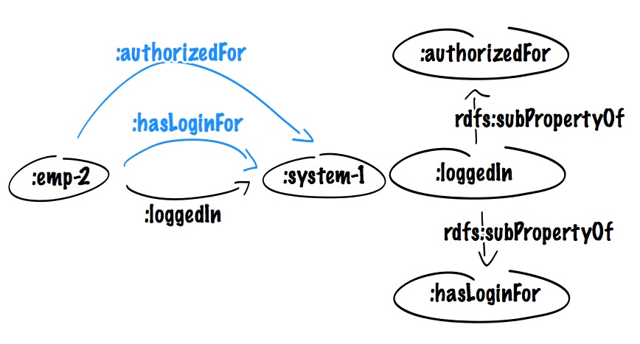
Set “intersection”
Similar for roles

Slide 21
Set “intersection”
Similar for roles

Slide 22
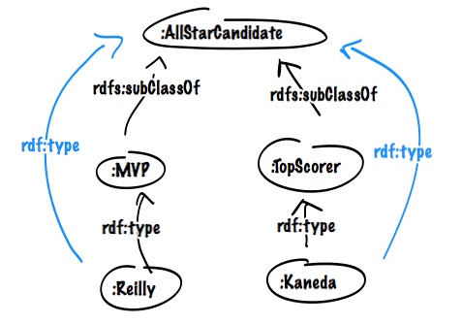
Set “union”
Proper set union is not possible in RDFS
However, A OR B subsetOf C
B rdfs:subClassOf A
C rdfs:subClassOf A
consider
x rdf:type B
or
x rdf:type C

Slide 23
Set “union”
Proper set union is not possible in RDFS
However, A OR B subsetOf C
B rdfs:subClassOf A
C rdfs:subClassOf A
consider
x rdf:type B
or
x rdf:type C

Slide 24
Classes in RDF/XML Syntax
Abbreviated notation for specifying class instances:
<ex:HomoSapiens rdf:about="&ex;WernerNutt"/>
instead of
<rdf:Description rdf:about="&ex;WernerNutt">
<rdf:type rdf:resource="&ex;HomoSapiens">
</rdf:Description>
Likewise:
<rdfs:Class rdf:about="&ex;HomoSapiens"/>

Slide 25
Predefined Class URIs
rdfs:Resource
class of all resources (i.e., all elements of the domain)
rdf:Property
class of all relationships
(= those resources, that are referenced via predicate URIs)
rdf:List, rdf:Seq, rdf:Bag, rdf:Alt, rdfs:Container
diverse kinds of lists
rdfs:ContainerMembershipProperty
class of all relationships that represent a containedness relationship

Slide 26
Predefined Class URIs/2
rdf:XMLLiteral
class of all values of the predefined datatype XMLLiteral
rdfs:Literal
class of all literal values
(every datatype is a subclass of this class)
rdfs:Datatype
class of all datatypes
(therefore it is a class of classes, similar to rdfs:Class)
rdf:Statement
class of all reified propositions

Slide 27
Motivation
Classes and Class Hierarchies
Properties and Property Hierarchies
Property Restrictions
Open Containers
Additional Information in RDFS
Simple Ontologies

Slide 28
Properties
Properties characterize, in which way two resources are related to each other
  also called: relations, relationships
Beware: unlike in OOP, properties in RDF(S)
are not assigned to classes
Property URIs normally appear
in the predicate position of a triple
Mathematically, the content of a property/relation
is sometimes represented as set of pairs:
marriedWith = {(Adam, Eve), (Brad, Angelina), . . .}
A URI can be marked as property name by typing it accordingly:
ex:publishedBy rdf:type rdf:Property .

Slide 29
Subproperties
Like sub-/superclasses, also sub-/superproperties
are possible and useful
Specification in RDFS via rdfs:subPropertyOf, e.g.:
ex:happilyMarriedWith rdf:subPropertyOf
ex:marriedWith .
Inference:
Given
ex:mark ex:happilyMarriedWith ex:ann .
we can infer
ex:mark ex:marriedWith ex:ann .

Slide 30
Motivation
Classes and Class Hierarchies
Properties and Property Hierarchies
Property Restrictions
Open Containers
Additional Information in RDFS
Simple Ontologies

Slide 31
Property Restrictions
Often: Usage of a property only makes sense for a certain kinds of resources, e.g.
ex:publishedBy only connects publications with publishers
➔ for all URIs a, b, the triple
a ex:publishedBy b .
intuitively entails:
a rdf:type ex:Publication .
b rdf:type ex:Publisher .
We can express this directly in RDFS:
ex:publishedBy rdfs:domain ex:Publication .
ex:publishedBy rdfs:range ex:Publisher .
Can also be used to “prescribe” datatypes for literals:
ex:hasAge rdfs:range xsd:nonNegativeInteger .
domain restriction
range restriction

Slide 32
Property Restrictions/2
Property restrictions are the only way of specifying semantic interdependencies between properties and classes
Attention: property restrictions are interpreted globally and conjunctively.
E.g., what follows from
ex:authorOf rdfs:range ex:Cookbook .
ex:authorOf rdfs:range ex:Storybook .
ex:fred ex:authorOf ex:fredsBook . ?
➔ This entails: ex:fredsBook is both a cookbook and a
storybook
Thus: When designing an RDFS schema,
pick the most general possible class for domain/range specifications

Slide 33
Motivation
Classes and Class Hierarchies
Properties and Property Hierarchies
Property Restrictions
Open Containers
Additional Information in RDFS
Simple Ontologies

Slide 34
Open Containers
Reminder: open collections in RDF

Slide 35
Open Containers/2
New class: rdfs:Container as superclass of
rdf:Seq, rdf:Bag, rdf:Alt
New class: rdfs:ContainerMembershipProperty:
instances of this class are no proper individuals,
but themselves properties
Intended semantics: every property encoding that
the subject contains the object
is an instance of
rdfs:ContainerMembershipProperty
In particular, we have
rdf: 1 rdf:type rdfs:ContainerMembershipProperty .
rdf: 2 rdf:type rdfs:ContainerMembershipProperty .
etc.

Slide 36
Open Containers/3
New property: rdfs:member
superproperty of all properties that are instances of
rdfs:ContainerMembershipProperty,
could be called the “universal containedness relation”
Part of the semantics of RDFS:
whenever for a property p the triple
p rdf:type rdfs:ContainerMembershipProperty .
holds, then the triple
a p b.
gives rise to the triple
a rdfs:member b .

Slide 37
Motivation
Classes and Class Hierarchies
Properties and Property Hierarchies
Property Restrictions
Open Containers
Additional Information in RDFS
Simple Ontologies

Slide 38
Additional Information in RDFS
Like with programming languages, one sometimes wants to add comments (without changing the semantics)
Purpose: increase understandability for human users
Format of comments in graph?
  comments are nodes
  a comment node is attached to the commented node
  attachment is achieved by a suitable property
➔ Task: define a set of properties that serve this purpose

Slide 39
Additional Information/2
rdfs:label
Property that assigns a name (Literal) to an arbitrary resource
Often, URIs themselves are difficult to read, or “bulky” at best
Names provided via rdfs:label are often used by tools that graphically represent the data
Example (also featuring language information):
<rdfs:Class rdf:about="&ex;Hominidae">
<rdfs:label xml:lang="en">great apes</rdfs:label>
</rdfs:Class>

Slide 40
Additional Information/3
rdfs:comment
Property assigning an extensive comment (literal)
to an arbitrary resource
may e.g. contain the natural language description of a newly introduced class – this facilitates later usage
rdfs:seeAlso, rdfs:definedBy
Properties giving resources (URIs!)
where one can find further information or a definition
of the subject resource

Slide 41
Additional Information/4
Example of usage
…
xmlns:wikipedia=http://en.wikipedia.org/wiki
…
<rdfs:Class rdf:about="&ex;Primates">
<rdfs:label xml:lang="en">Primates</rdfs:label>
<rdfs:comment>An order of mammals. Primates are
characterized by a highly developed brain. Most
primates live in tropical or subtropical regions.
</rdfs:comment>
<rdfs:seeAlso rdfs:resource="&wikipedia;Primate"/>
<rdfs:subClassOf rdfs:resource="&ex;Mammalia"/>
</rdfs:Class>

Slide 42
Motivation
Classes and Class Hierarchies
Properties and Property Hierarchies
Property Restrictions
Open Containers
Additional Information in RDFS
Simple Ontologies

Slide 43
Simple Ontologies
By means of the modeling features of RDFS,
important aspects of many domains can already be captured semantically.
Based on the RDFS semantics, a certain amount of implicit knowledge can be derived.
Consequently, RDFS can be seen as a
(though not overly expressive) ontology language.

Slide 44
Exercise
Express in RDF and RDFS:
Vegetable Thai curry is a Thai dish based on coconut milk.
Fred is allergic to nuts.
Fred eats vegetable Thai curry.
Everyone allergic to nuts is pitiable.
Everything having the property “Thai dish based on” is Thai.
Everything satisfying the property “Thai dish based on” is nutty.
The property “Thai dish based on” is a special case of the property “has ingredient”
“Has ingredient” is a containedness relation.

Slide 45
Simple Ontology – Example
ex:vegetableThaiCurry ex:thaiDishBasedOn ex:coconutMilk .
ex:fred rdf:type ex:AllergicToNuts .
ex:fred ex:eats ex:vegetableThaiCurry .
ex:AllergicToNuts rdfs:subClassOf ex:Pitiable .
ex:thaiDishBasedOn rdfs:domain ex:Thai .
ex:thaiDishBasedOn rdfs:range ex:Nutty .
ex:thaiDishBasedOn rdfs:subPropertyOf ex:hasIngredient .
ex:hasIngredient rdf:type rdfs:ContainerMembershipProperty .
What would this look like graphically?
Distinguish between
assertional knowledge
terminological knowledge

Slide 46
Simple Ontology – Example
ex:vegetableThaiCurry ex:thaiDishBasedOn ex:coconutMilk .
ex:fred rdf:type ex:AllergicToNuts .
ex:fred ex:eats ex:vegetableThaiCurry .
ex:AllergicToNuts rdfs:subClassOf ex:Pitiable .
ex:thaiDishBasedOn rdfs:domain ex:Thai .
ex:thaiDishBasedOn rdfs:range ex:Nutty .
ex:thaiDishBasedOn rdfs:subPropertyOf ex:hasIngredient .
ex:hasIngredient rdf:type rdfs:ContainerMembershipProperty .
ex:Pitiable
rdfs:ContainerMembershipProperty
rdf:type
rdfs:subClassOf
ex:Thai
ex:hasIngredient
ex:Nutty
rdfs:domain
rdfs:subPropertyOf
rdfs:range
ex:AllergicToNuts
ex:thaiDishBasedOn
terminological knowledge (RDFS)
assertional knowledge (RDFS)
rdf:type
ex:eats
ex:thaiDishBasedOn
ex:fred
ex:vThaiCurry
ex:coconutMilk

Slide 47
One Document – Three Interpretations
<rdf:Description rdf:ID="Truck">
<rdf:type rdf:resource=
"http://http://www.w3.org/2000/02/rdf-schema#Class"/>
<rdfs:subClassOf rdf:resource="#MotorVehicle"/>
</rdf:Description>
Interpretation 1: An XML tree
[Fill in a drawing!]

Slide 48
One Document – Three Interpretations
<rdf:Description rdf:ID="Truck">
<rdf:type rdf:resource=
"http://http://www.w3.org/2000/02/rdf-schema#Class"/>
<rdfs:subClassOf rdf:resource="#MotorVehicle"/>
</rdf:Description>
Interpretation 2: An RDF dataset
[Fill in a drawing!]

Slide 49
One Document – Three Interpretations
<rdf:Description rdf:ID="Truck">
<rdf:type rdf:resource=
"http://http://www.w3.org/2000/02/rdf-schema#Class"/>
<rdfs:subClassOf rdf:resource="#MotorVehicle"/>
</rdf:Description>
Interpretation 3: An RDFs schema
[Fill in a drawing!]

Slide 50
RDFS Exercise
Decide whether the following propositions can be satisfactorily modeled in RDFS and, if so, give the corresponding RDF(S) specification.
Every pizza is a meal.
Pizzas always have at least two toppings.
Every pizza from the class PizzaMargarita has a Tomato topping.
Everything having a topping is a pizza.
No pizza from the class PizzaMargarita has a topping from the class Meat.
“Having a topping” is a containedness relation.

Slide 51
RDFS Inferences
In RDFS, we can express statements about
resources/nodes being a member of a classes
classes being subclasses of other classes
properties being subproperties of other properties
classes being domains and ranges of properties
What conclusions can we draw from such statements?
How do these statements interact?

Slide 52
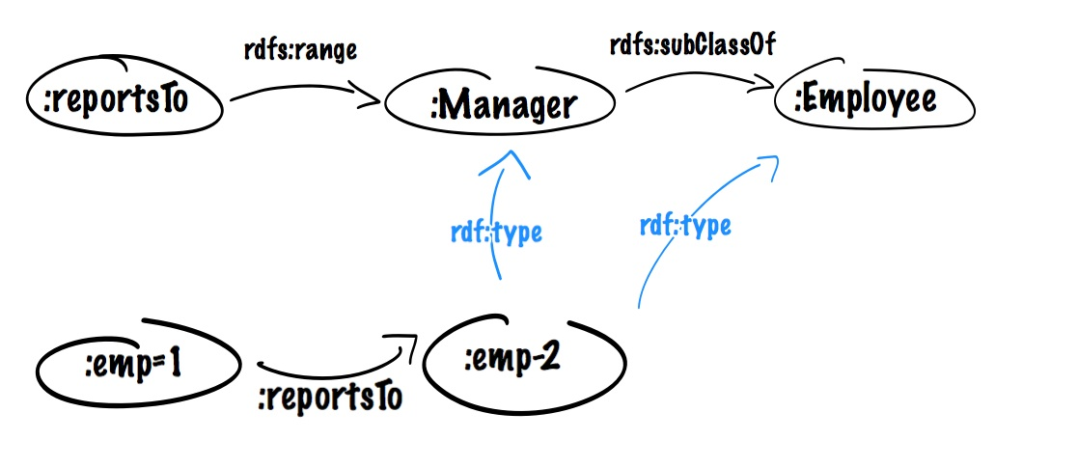
Interactions
All inferences interact

