Slide 1
The RDF Data Model
Werner Nutt

Slide 2
Acknowledgment
These slides are based on the slide set
RDF By Mariano Rodriguez (see http://www.slideshare.net/marianomx)

Slide 3
History and Motivation
Naming: URIs, IRIs, Qnames
RDF Data Model: Triples, Literals, Types
Modeling with RDF: BNodes, n-ary Relations, Reification
Containers

Slide 4
History and Motivation
Naming: URIs, IRIs, Qnames
RDF Data Model: Triples, Literals, Types
Modeling with RDF: BNodes, n-ary Relations, Reification
Containers

Slide 5
RDF stands for …
Resource Description Framework
Notes:
Definition.

Slide 6
History
RDF originated as a format for structuring metadata about Web sites, pages, etc.
Page author, creator, publisher, editor, …
Data about them: email, phone, job, …
First version in W3C Recommendation of 1999
specified serialization in XML
Metadata = Data ➔ RDF is a general data format
Berners-Lee, Hendler, and Lassila proposed RDF as the model for data exchange on the Semantic Web (see their paper in Scientific American, 2001)

Slide 7
RDF is…
… the data model of Semantic Technologies and of the Semantic Web
Notes:
Prescriptive.

Slide 8
Two Views of RDF
Intuitively, an RDF data set is a labeled, directed graph ➔ what are the nodes? and what are the edge labels?
Technically, an RDF data contains triples of the form Subject Predicate Object . ➔ what are subjects, predicates, and objects?

Slide 9
Example
Info about Boston, People, ISWC 2010, …
[taken from the tutorial of Sandro Hawke on RDF at ISWC 2010, which took place in …]

Slide 10
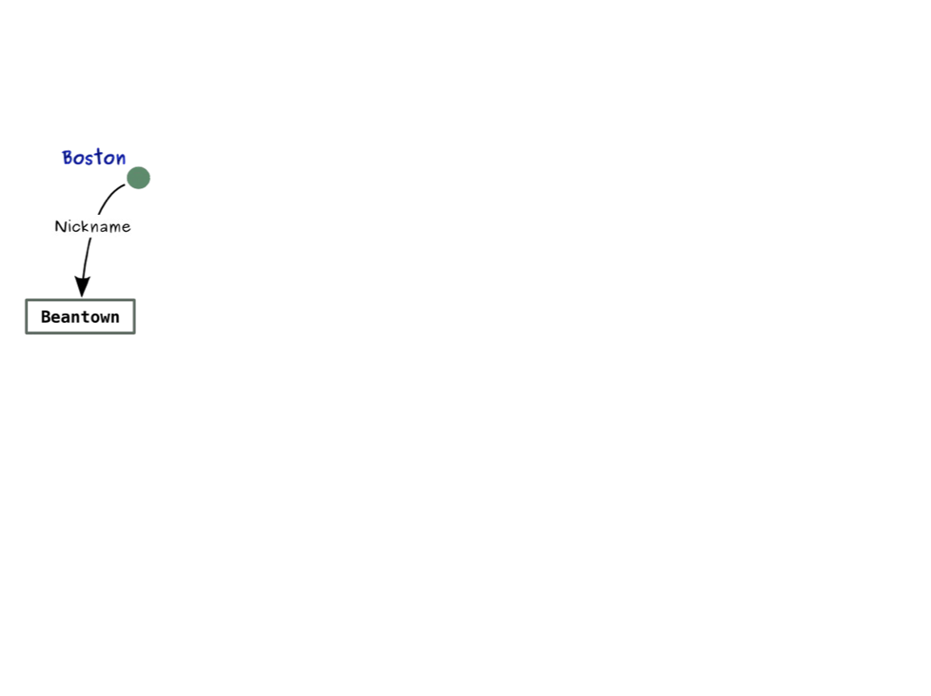

Slide 11
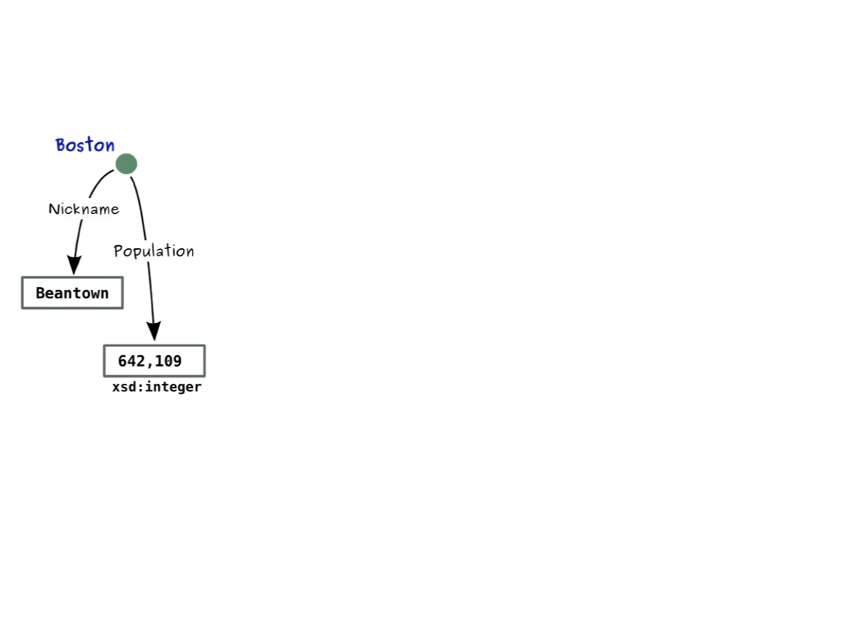

Slide 12
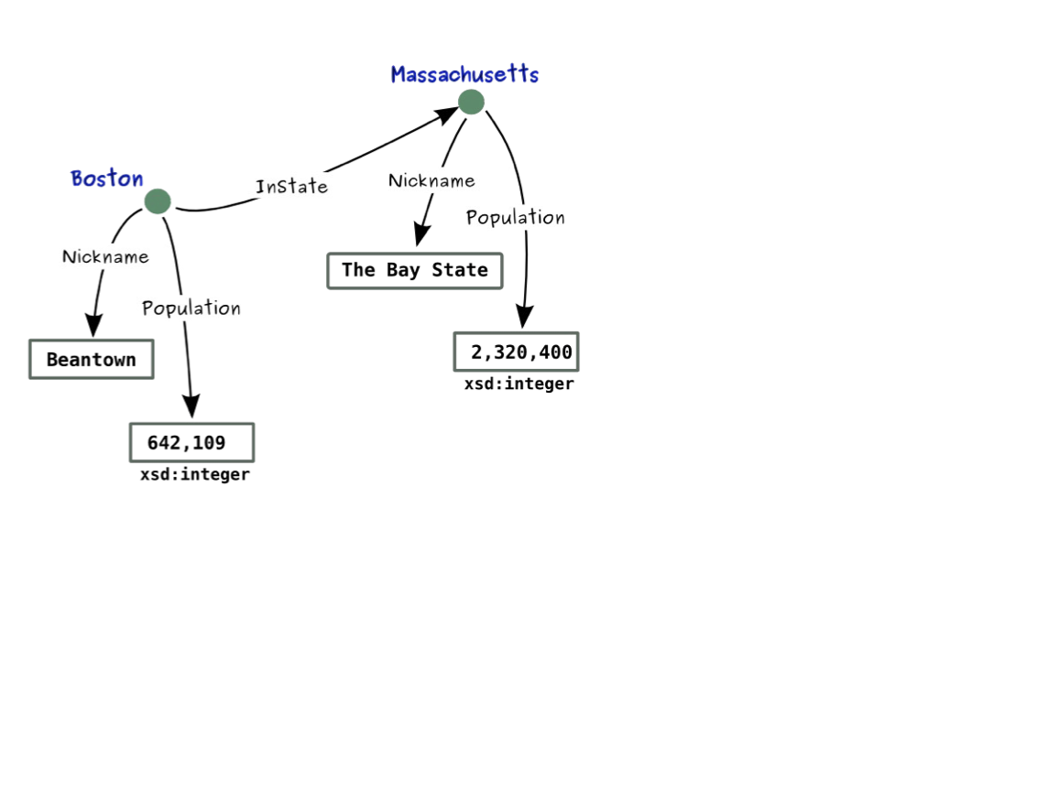

Slide 13
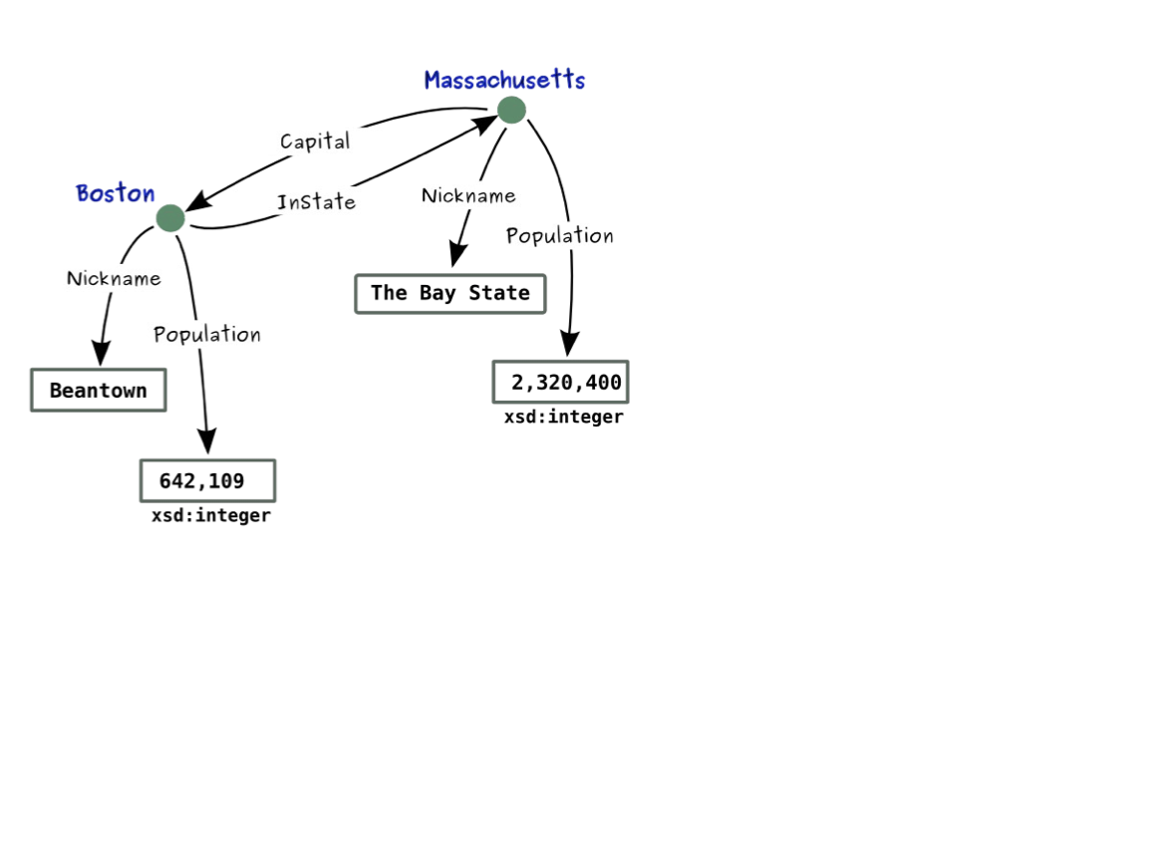

Slide 14
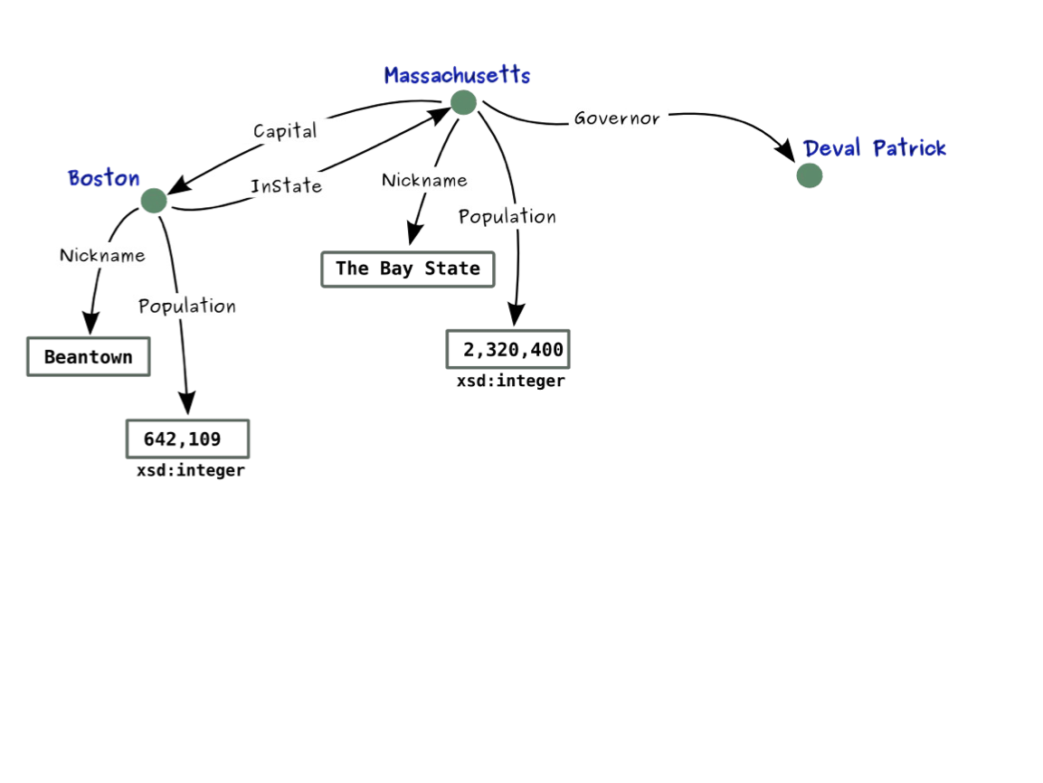

Slide 15
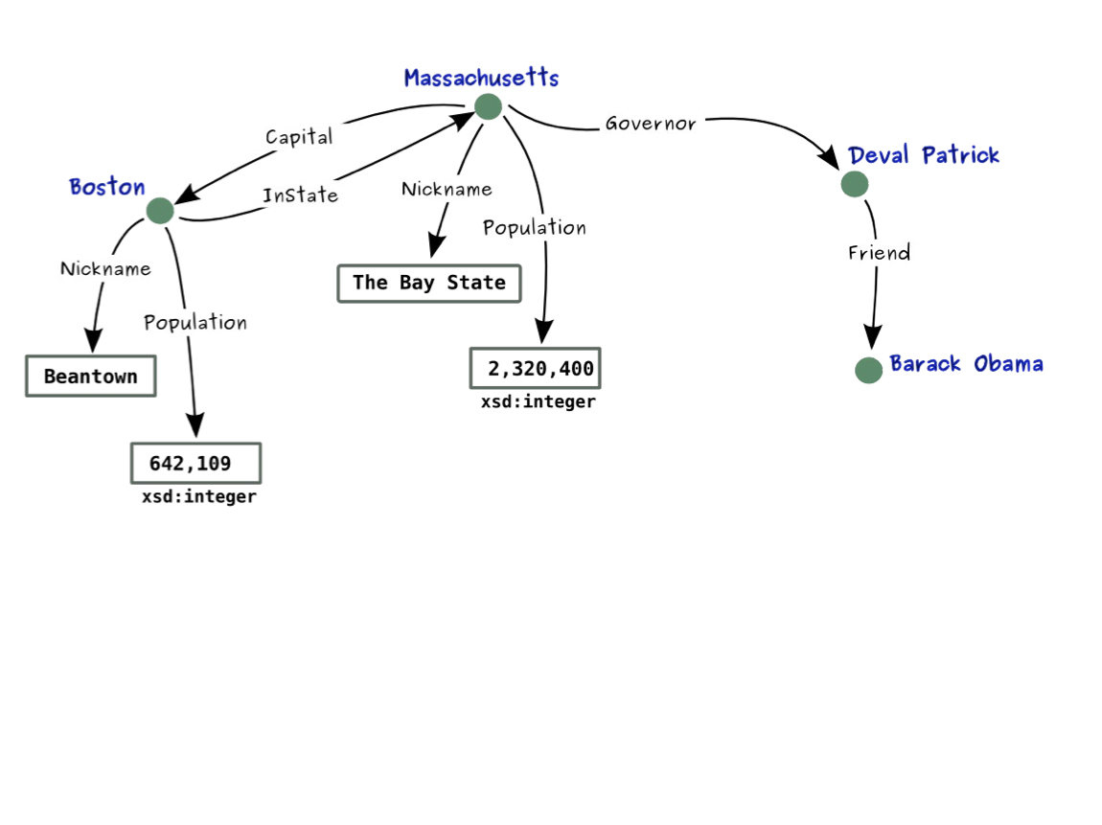

Slide 16
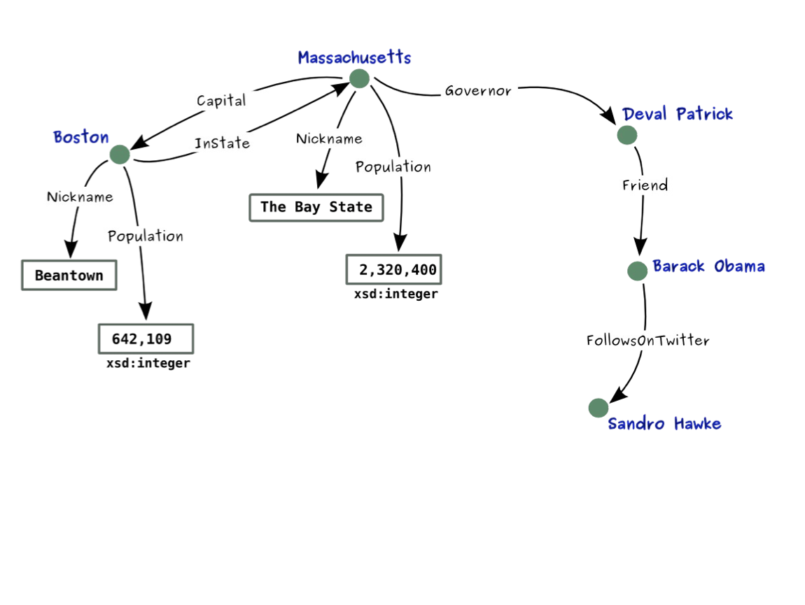

Slide 17
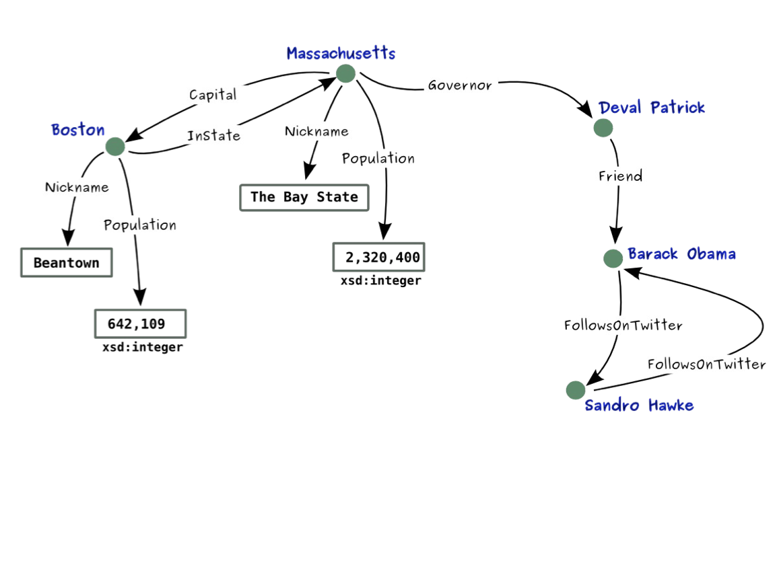

Slide 18
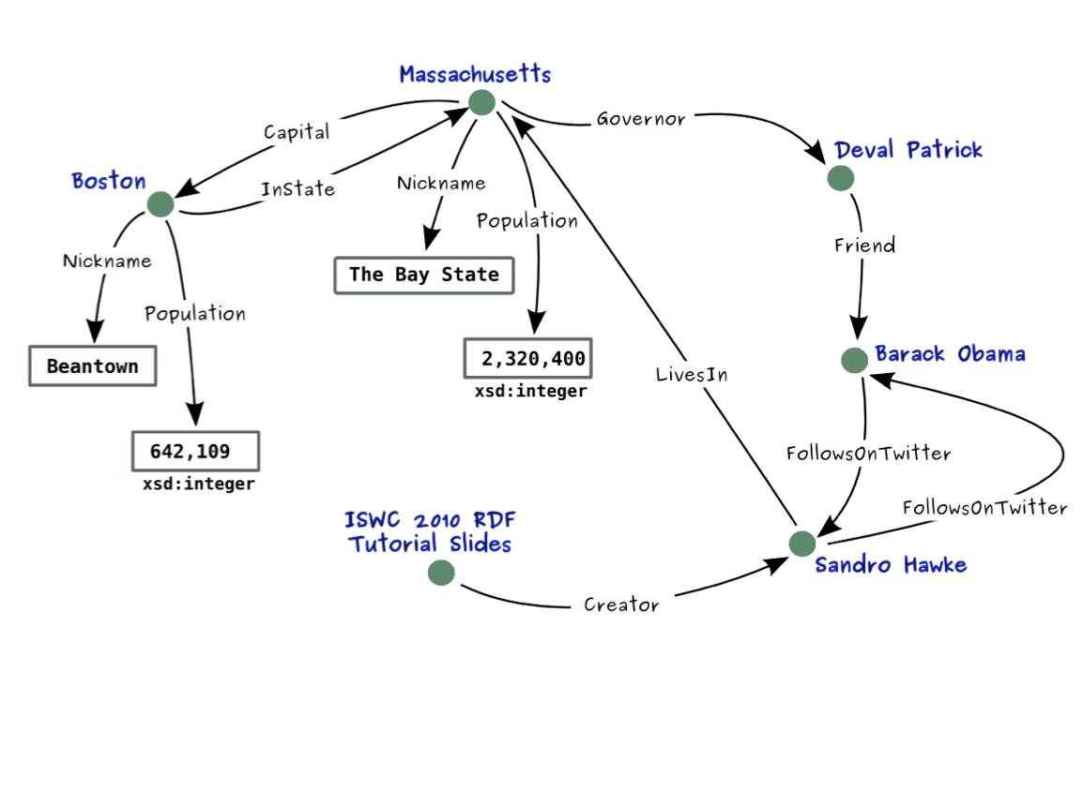

Slide 19
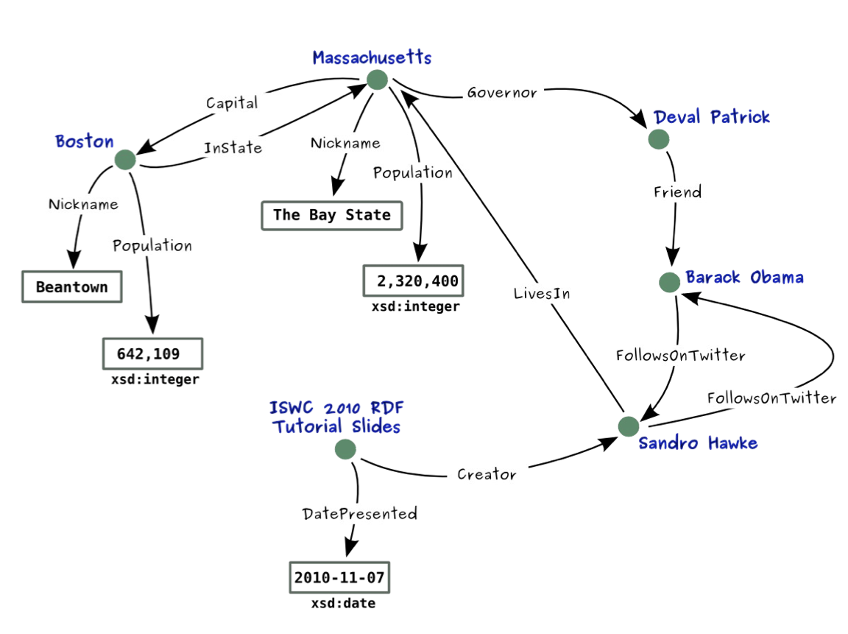

Slide 20
History and Motivation
Naming: URIs, IRIs, Qnames
RDF Data Model: Triples, Literals, Types
Modeling with RDF: BNodes, n-ary Relations, Reification
Containers

Slide 21
Unambiguous Names
How many things are named “Boston”? How about “Riverside”?
What is meant by “Nickname”? And what by “LivesIn”?
➔ We need unambiguous identifiers On the Web, we have URLs, URIs, and IRIs

Slide 22
URLs, URIs and IRIs
We know basic Web addresses
http://google.com
https://gmail.com
http://www.inf/unibz.it/
http://www.inf/unibz.it/~nutt/
URL (= Uniform Resource Locator) Web address of an information resource (Web page, image, zip file, …)

Slide 23
URLs, URIs and IRIs (cntd)
URI (= Uniform Resource Identifier) In most cases, looks like a URL, but might identify something else (person, place, concept)
Every URL is also a URI, but not vice versa
Was known as URN (= Uniform Resource Names)
Supports ISBN numbers (e.g., urn:isbn:0-486-27557-4)
IRI (= Internationalized Resource Identifier)
Uses Unicode instead of ASCII (e.g., http://ヒキワリ.ナットウ.ニホン)
Every IRI can be turned into a URI (%-encoding)
URLs ⊆ URIs ⊆ IRIs

Slide 24
URI, URL and IRI: Syntax
scheme: type of URI, e.g. http, ftp, mailto, file, irc
authority: typically a domain name
path: e.g. /etc/passwd/
query: optional; provides non-hierarchical information. Usually for parameters, e.g. for a web service
fragment: optional; often used to address part of a retrieved resource, e.g. section of a HTML file.
scheme:[//authority]path[?query][#fragment]
IRI design is important for semantic applications. More later.

Slide 25
The URI Quiz
Using URIs to identify things
ensures that there are not two different names (URIs) for the same thing
ensures that one name (URI) is not used for two different things
makes it easier to avoid using one name (URI) for two different things
What is correct?

Slide 26
QNames
Used in RDF as shorthand for long URIs: If prefix foo is bound to http://example.com/ then foo:bar expands to http://example.com/bar
Not quite the same as XML namespaces.
Practically relevant due to syntactic restrictions on formats for data exchange (in particular, XML)
Necessary to fit any example on a page! Simple string concatenation

Slide 27
Unambiguous Names (cntd)
How many things are named “Boston”?
➔ So, we use URIs. Instead of “Boston”:
http://dbpedia.org/resource/Boston
QName: db:Boston
➔ And instead of “Nickname” we use:
http://example.org/terms/nickname
QName: dbo:nickname
Note: we have to say somewhere that “db” is a shorthand for “http://dbpedia.org/resource/Boston/”

Slide 28
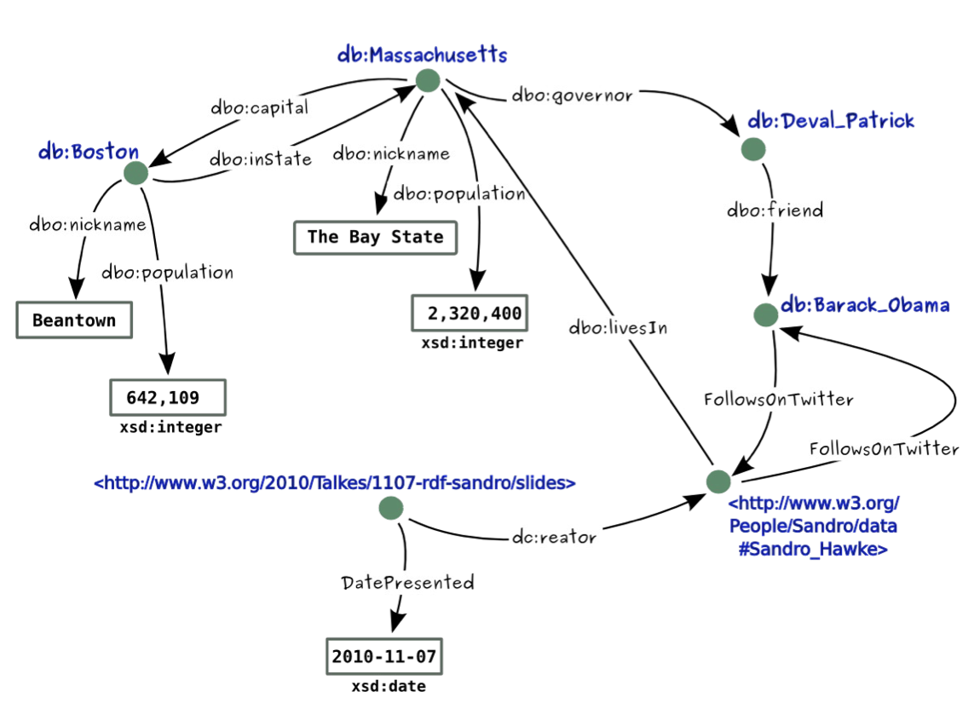

Slide 29
RDF is…
a schema-less data model that features unambiguous identifiers and named relations
between pairs of resources.
Notes:
Descriptive.

Slide 30
Why RDF? What’s Different Here?
The graph data structure makes merging data with shared identifiers trivial (as we saw earlier)
Triples act as a least common denominator for expressing data
URIs for naming remove ambiguity
…the same identifier means the same thing
Notes:
The first is as opposed to relational tables or XML schemas where the schema needs to be explicitly adjusted to accommodate whatever data is being merged.
The second is due to the expressivity of the model – can handle lists, trees, n-ary relations, etc.
The third is as opposed to table & column identifiers or XML attribute names.

Slide 31
History and Motivation
Naming: URIs, IRIs, Qnames
RDF Data Model: Triples, Literals, Types
Modeling with RDF: BNodes, n-ary Relations, Reification
Containers

Slide 32
RDF is…
A labeled, directed graph of relations between resources and literal values.
RDF graphs are sets of triples
Triples are made up of a subject, a predicate, and an object (spo)
Resources and relationships are named with URIs
subject
predicate
object
Notes:
Formal.

Slide 33
Triple
Resources are: IRI (denotes an object)
Subjects: Resource or blank-node
Predicates: Resource
Object: Resource, literal or blank-node
A triple is also called a “statement”
Notes:
The first is as opposed to relational tables or XML schemas where the schema needs to be explicitly adjusted to accommodate whatever data is being merged.
The second is due to the expressivity of the model – can handle lists, trees, n-ary relations, etc.
The third is as opposed to table & column identifiers or XML attribute names.

Slide 34
Turtle Syntax
Turtle = Terse RDF Triple Language
Simple syntax for RDF
defined by Dave Beckett as a subset of Tim Berners-Lee and Dan Connolly's Notation3 (N3) language
standardized by a W3C recommendation since February 2014
In Turtle, triples are directly listed as such: S P O
IRIs are in < angle brackets >
End with full-stop “.”
Whitespaces are ignored

Slide 35
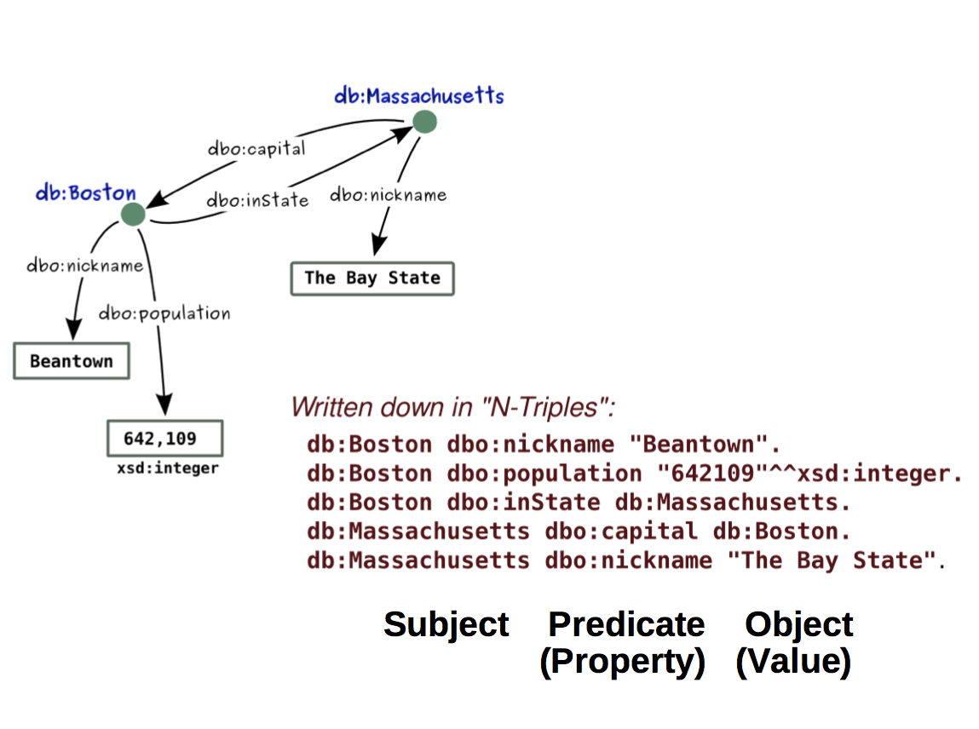

Slide 36
In Turtle
<http://dbpedia.org/resource/Massachusets> <http://example.org/terms/captial>
<http://dbpedia.org/resource/Boston> .
<http://dbpedia.org/resource/Massachusets> <http://example.org/terms/nickname>
“The Bay State” .
<http://dbpedia.org/resource/Boston> <http://example.org/terms/inState>
<http://dbpedia.org/resource/Massachusets> .
<http://dbpedia.org/resource/Boston> <http://example.org/terms/nickname>
“Beantown” .
<http://dbpedia.org/resource/Boston> <http://example.org/terms/population>
“642,109”^^xsd:integer .

Slide 37
Shortcuts
Prefixes (simple string concatenation)
Grouping of triples with the same subject using semi-colon ‘;’
Grouping of triples with the same subject and predicate using comma ‘,’

Slide 38
@prefix db: <http://dbpedia.org/resource/>
@prefix dbo: <http://example.org/terms/>
db:Massachusets dbo:capital db:Boston .
db:Massachusets dbo:nickname “The Bay State” .
db:Boston dbo:inState db:Massachusets .
db:Boston dbo:nickname “Beantown” .
db:Boston dbo:population “642,109”^^xsd:integer .

Slide 39
@prefix db: <http://dbpedia.org/resource/>
@prefix dbo: <http://example.org/terms/>
db:Massachusets dbo:captial db:Boston ;
dbo:nickname “The Bay State” .
db:Boston dbo:inState db:Massachusets ;
dbo:nickname “Beantown” ;
dbo:population “642,109”^^xsd:integer .

Slide 40
Literals
Represent data values
Encoded as strings (the value)
Can be interpreted by means of datatypes
Literals without a type are treated the same as string (but they are not equal to strings)
An literal without a type is called plain literal. A plain literal may have a language tag.
Datatypes are not defined by RDF, people commonly use datatypes from XML Schema (XSD)
RDF does not require implementation support for any datatype. However, systems generally implement most of XSD datatypes.
Notes:
The first is as opposed to relational tables or XML schemas where the schema needs to be explicitly adjusted to accommodate whatever data is being merged.
The second is due to the expressivity of the model – can handle lists, trees, n-ary relations, etc.
The third is as opposed to table & column identifiers or XML attribute names.

Slide 41
Literals (cont.)
Typed literal:
“Mariano”^^xsd:string, “12-12-12”^^xsd:date
Plain literal and literals with language
“France” “France”@fr “Frankreich”@de
Equalities under simple RDF interpretation (lexical form matters):
“Mariano” != “Mariano”@es != “Mariano”^^xsd:string
“001”^^xsd:integer = “1”^^xsd:integer
Notes:
The first is as opposed to relational tables or XML schemas where the schema needs to be explicitly adjusted to accommodate whatever data is being merged.
The second is due to the expressivity of the model – can handle lists, trees, n-ary relations, etc.
The third is as opposed to table & column identifiers or XML attribute names.

Slide 42
Literals (cont.)
Equalities under typed interpretation (lexical form does not matter):
“123”^^xsd:integer = “0123”^^xsd:integer
Type hierarchy: “123.0”^^xsd:decimal = “00123”^^xsd:integer
Notes:
The first is as opposed to relational tables or XML schemas where the schema needs to be explicitly adjusted to accommodate whatever data is being merged.
The second is due to the expressivity of the model – can handle lists, trees, n-ary relations, etc.
The third is as opposed to table & column identifiers or XML attribute names.

Slide 43
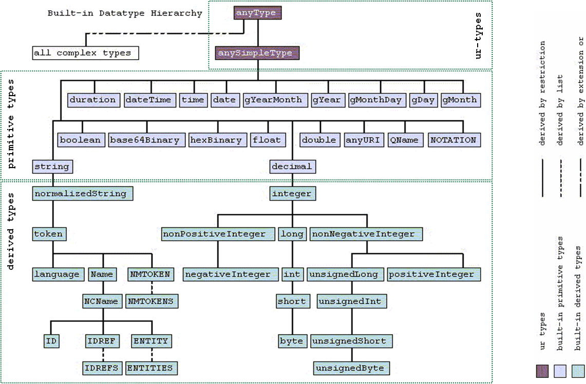

Slide 44
Type definition
Datatypes can be defined by the user, as with XML
New “derived simple types” are derived by restriction, as with XML. Complex types based on enumerations, unions and list are also possible. Example:
<xsd:schema ...>
<xsd:simpleType name="humanAge">
<xsd:restriction base="integer">
<xsd:minInclusive value="0">
<xsd:maxExclusive value="150">
</xsd:restriction>
</xsd:simpleType>
...
</xsd:schema>

Slide 45
History and Motivation
Naming: URIs, IRIs, Qnames
RDF Data Model: Triples, Literals, Types
Modeling with RDF: BNodes, N-ary Relations, Reification
Containers

Slide 46
Modeling with RDF
Lets revisit our motivational examples and do some modeling in RDF ourselves.
Given the following relational data, generate an RDF graph
Notes:
Request for volunteers

Slide 47
Exercise: Data set “A”: A simplified Book Store
Sellers
<ID> | Author | Title | <Publisher> | Year
ISBN0-00-651409-X | id_xyz | The Glass Palace | id_qpr | 2000
Authors
<ID> | Name | Home page
id_xyz | Ghosh, Amitav | http://www.amitavghosh.com
Stores
Generate an RDF graph.
Keys are marked with <>.
Primary keys are underscored.
Steps: 1) Generate the graph 2) Adjust identifiers 3) Adjust names of relations and types
<ID> | Publisher Name
am | Amazon
bn | Barnes & Nobel
Notes:
Do this in the class

Slide 48
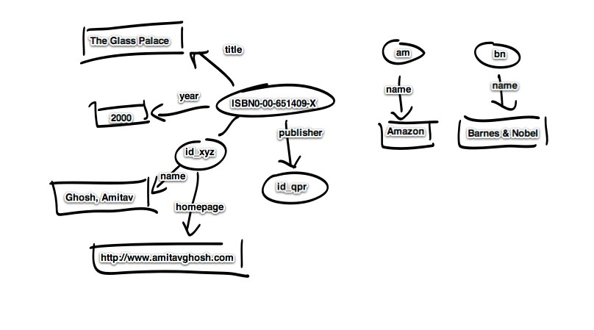
Relational to Graph (not yet RDF)
Notes:
Missing in this model, proper uris/bnodes/relation names

Slide 49
Insert …
Types
Proper URIs, e.g., using
@prefix ex: http://example.org/
Blank nodes

Slide 50
Blank Nodes
Nodes without a IRI
Unnamed resources
Complex nodes (later)
Representation of blank nodes is syntax-dependent
In Turtle we use underscore followed by colon, then an ID
_:b0 _:nodeX
The scope of the ID of a blank node is only the document to which it belongs. That is, two different RDF files that contain the blank node _:n0 do not refer to the same node.

Slide 51
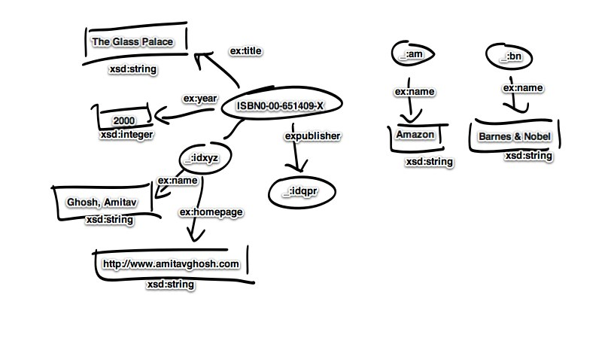
With Proper URI’s and BNodes
Notes:
missing in this m model, talbe names, table names have information about type. This can also be added to the RDF data with rdf:type edges/properties.

Slide 52
Insert also…
Classes/Types
invent new class names for your vocabulary
class names are URIs (like everything else)
Class membership links, using the predicate
rdf:type
Syntax: dbo:Boston rdf:type ex:City
with @prefix ex:http//example.org/

Slide 53
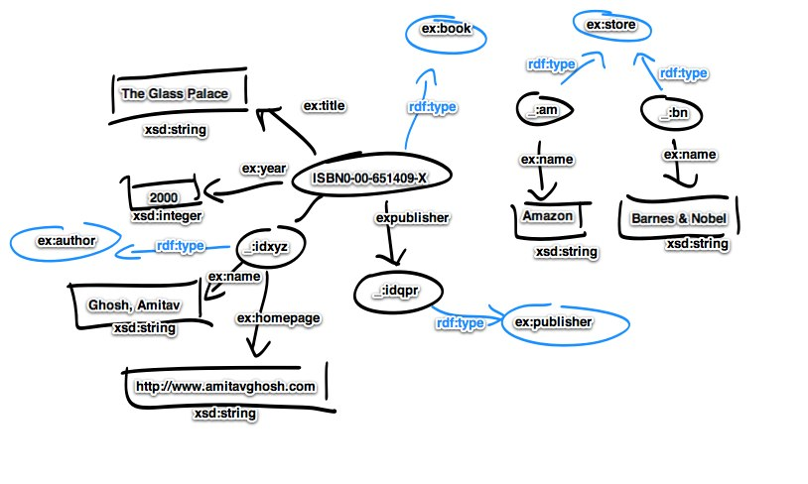
Complete with rdf:type
In the lab: Generate a turtle file for this graph.
Additionally, transform it into n3 and RDF/XML file using Sesame or Jena

Slide 54
Data set “A+”: The Simplified Book Store
Sellers
<ID> | Author | Title | <Publisher> | Year
ISBN0-00-651409-X | id_xyz | The Glass Palace | id_qpr | 2000
Authors
<ID> | Name | Home page
id_xyz | Ghosh, Amitav | http://www.amitavghosh.com
Stores
Sold-By
<ID> | Publisher Name
am | Amazon
bn | Barnes & Nobel
<Book> | <Store> | Price
ISBN0-00-651409-X | am | 22.50
ISBN0-00-651409-X | bn | 21.00
Notes:
Do this in the class

Slide 55
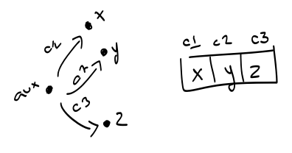
N-ary Relations
Not all relations are binary
All n-ary relations can be “encoded” as a set of binary relations using auxiliary nodes.
This process is called “reification” in conceptual modeling (do not confuse with reification in RDFS, to come later).

Slide 56
Data set “A+”: The Simplified Book Store
Sellers
ID | Author | Title | Publisher | Year
ISBN0-00-651409-X | id_xyz | The Glass Palace | id_qpr | 2000
Authors
ID | Name | Home page
id_xyz | Ghosh, Amitav | http://www.amitavghosh.com
Stores
Sold-By
ID | Publisher Name
am | Amazon
bn | Barnes & Nobel
Book | Store | Price
ISBN0-00-651409-X | am | 22.50
ISBN0-00-651409-X | bn | 21.00
Notes:
This is an in class

Slide 57
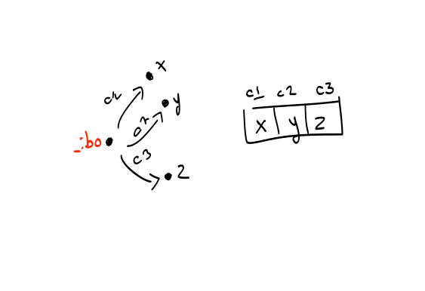
Use Blank Nodes to Model Tuples

Slide 58
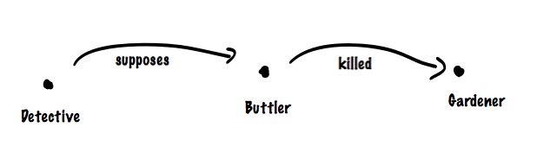
RDF Reification
How would you state in RDF:
“The detective supposes that the butler killed the gardener”

Slide 59
RDF Reification
How would you state in RDF:
“The detective supposes that the butler killed the gardener”

Slide 60
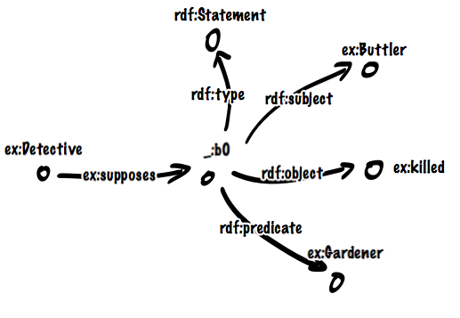
RDF Reification
Reification allows to state statements about statements
Use special vocabulary:
rdf:subject
rdf:predicate
rdf:object
rdf:Statement

Slide 61
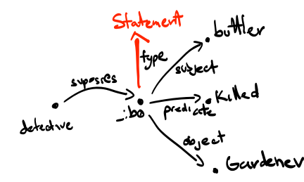
RDF Reification
Reification allows to state statements about statements
Use special vocabulary:
rdf:subject
rdf:predicate
rdf:object
rdf:Statement
Note: The triple
<Buttler> <Killed> <Gardener>
Is not in the graph.

Slide 62
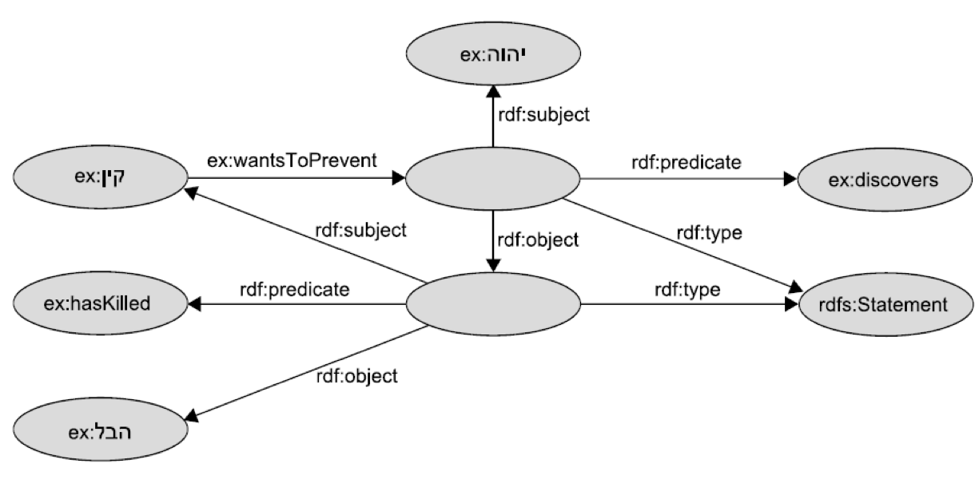
A Reification Puzzle
Know the story?

Slide 63
Exercise
Express the following natural language sentences as a graph:
Mary saw Eric eat ice cream
The professor explained that the scientific community regards evolution theory as correct

Slide 64
History and Motivation
Naming: URIs, IRIs, Qnames
RDF Data Model: Triples, Literals, Types
Modeling with RDF: BNodes, N-ary Relations, Reification
Containers

Slide 65
Containers
Groups of resources
rdf:Bag: Group, possibly with duplicates, no order
rdf:Seq: Group, possibly with duplicates, order matters
rdf:Alt: Group, indicates alternatives
Use rdf:type to indicate one type of container
Use container membership properties to enumerate:
rdf:_1, rdf:_2, rdf:_3, …, rdf:_n

Slide 66
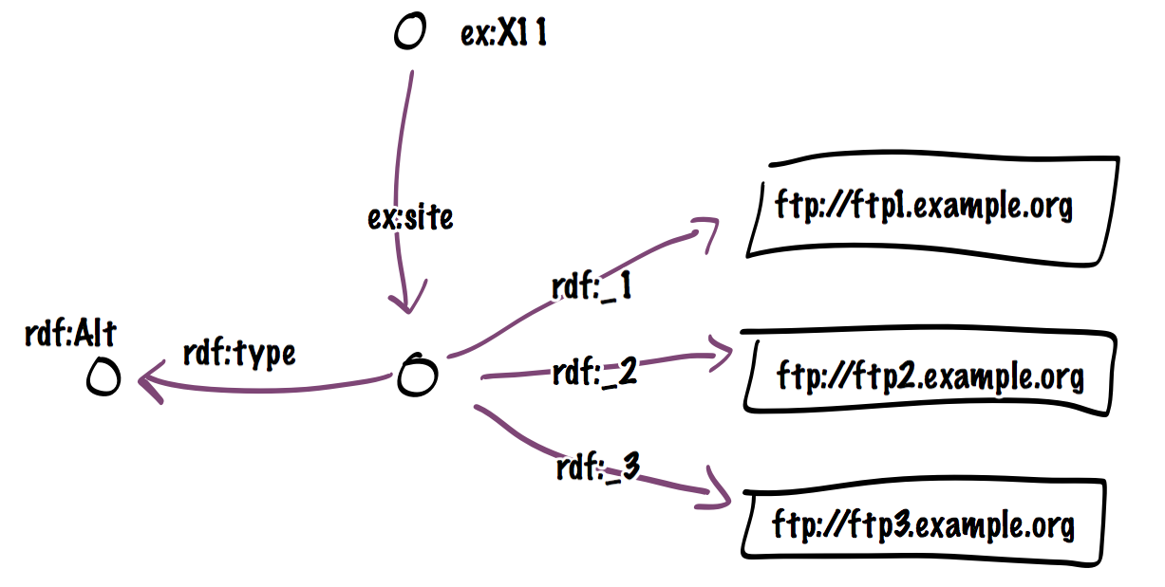
Example

Slide 67
Collections (Closed Containers)
Containers are open. No way to “close them”. Imposible to say “no other member exists”. Consider merging datasets.
Group of things represented as a linked list structure
The list is defined using the RDF vocabulary:
rdf:List,
rdf:first,
rdf:rest and
rdf:nil
Each member of the list is of type rdf:List (implicitly)

Slide 68
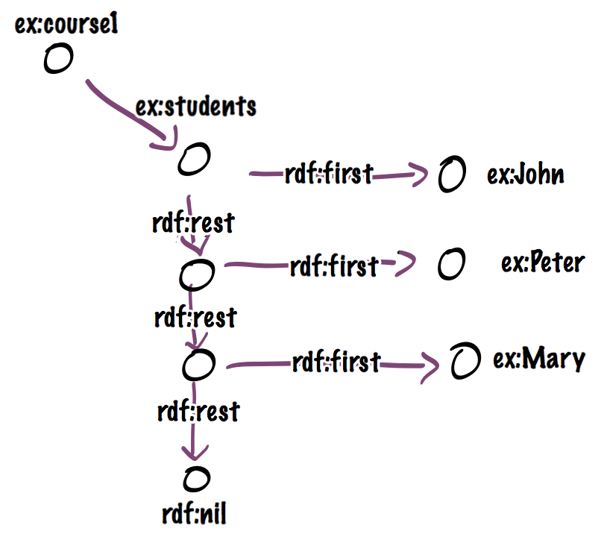
Example

Slide 69
Turtle
We already covered most of the nuts and bolts
Missing: Blank nodes, containers

Slide 70
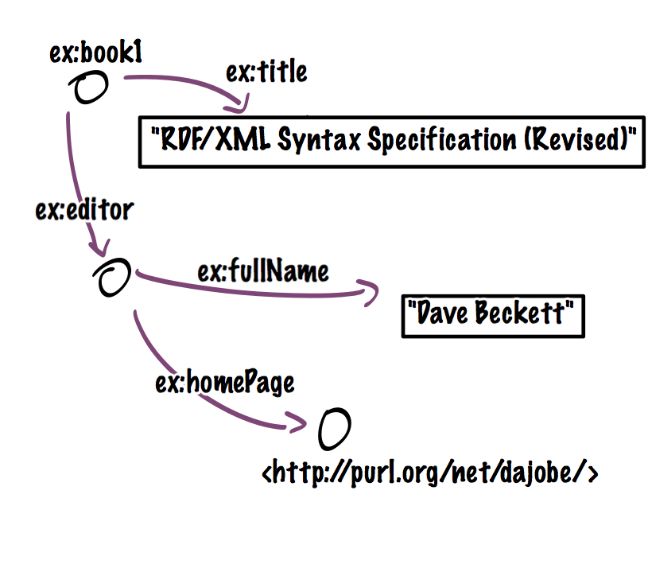
Blank Nodes
Use square brackets to define a blank node
ex:book1
ex:title "RDF/XML Syntax
Specification (Revised)";
ex:editor [
ex:fullName "Dave Beckett";
ex:homePage
<http://purl.org/net/dajobe/>
].

Slide 71
Exercise
Write in Turtle syntax with blank nodes a representation of
“Mary saw Eric eat ice cream”.

Slide 72
Containers
Use ( )
ex:coursel ex:students
(
ex:John
ex:Peter
ex:Mary
) .

Slide 73
Turtle
Advantages and uses:
Easy to read and write manually or programmatically
Good performance for IO, supported by many tools
The Turtle standard does not comprise containers

Slide 74
N-Triples
Turtle minus:
No prefix definitions are allowed
No reference shortcuts (semi-colon, comma)
Every other shortcut ☺
Very simple to parse/generate (even through scripts)
Supported by most tools
Very verbose. Wastes space/IO (problem is reduced with compression)

Slide 75
RDF/XML
W3C Standard since 1999, revised in 2004
Used to be the only standard
Standard XML (works with any XML tools)

