Slide 1
R2RML: RDB to RDF Mapping Language
Werner Nutt

Slide 2
Acknowledgment
These slides are based on a slide set by Mariano Rodriguez

Slide 3
Reading Material/Sources
R2RML specification by W3C http://www.w3.org/TR/r2rml/
R2RML specification byW3C http://www.w3.org/2001/sw/rdb2rdf/test-cases/

Slide 4
Standards and Tools
Mapping languages
Standards by RDB2RDF working group (W3C)
Direct Mapping
R2RML
Proprietary
Tools
Free: D2R, Virtuoso, Morph, r2rml4net, db2triples, ultrawrap, Quest
Commercial: Virtuoso, ultrawrap, Oracle SW

Slide 5
Detailed Specification
Books Example
Tools

Slide 6
Detailed Specification
Books Example
Tools

Slide 7
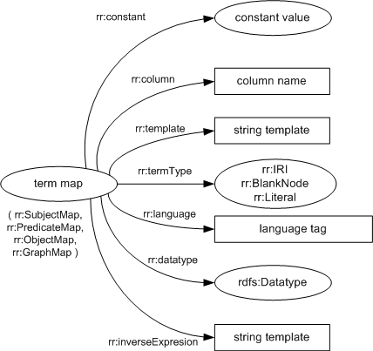
Creating RDF Terms with Term Maps
An RDF term is either an IRI, or a blank node, or a literal.
A term map is a function that generates an RDF term from a logical table row. The result of that function is known as the term map's generated RDF term.
Term maps are used to generate the subjects, predicates and objects of the RDF triples that are generated by a triples map.
There are several kinds of term maps, depending on where in the mapping they occur: subject maps, predicate maps, object maps and graph maps.

Slide 8
Constant RDF terms (rr:constant)
A constant-valued term map is a term map that ignores the logical table row and always generates the same RDF term. A constant-valued term map is represented by a resource that has exactly one rr:constant property.
The constant value of a constant-valued term map is the RDF term that is the value of its rr:constant property.
If the constant-valued term map is a subject map, predicate map or graph map, then its constant value must be an IRI.
If the constant-valued term map is an object map, then its constant value must be an IRI or literal.
The referenced columns of a constant-valued term map is the empty set.

Slide 9
Constant RDF term shortcurs
Constant-valued term maps can be expressed more concisely using the constant shortcut properties rr:subject, rr:predicate, rr:object and rr:graph. Occurrences of these properties must be treated exactly as if the following triples were present in the mapping graph instead:
Triple involving constant Replacement triples:
shortcut property:
?x rr:subject ?y. ?x rr:subjectMap [ rr:constant ?y ].
?x rr:predicate ?y. ?x rr:predicateMap [ rr:constant ?y ].
?x rr:object ?y. ?x rr:objectMap [ rr:constant ?y ].
?x rr:graph ?y. ?x rr:graphMap [ rr:constant ?y ].

Slide 10
Example
The following example shows a predicate-object map that uses a constant-valued term map both for its predicate and for its object.
If added to a triples map, this predicate-object map would add the following triple to all resources ?x generated by the triples map:
The following example uses constant shortcut properties and is equivalent to the example above:
[] rr:predicateMap [ rr:constant rdf:type ];
rr:objectMap [ rr:constant ex:Employee ].
?x rdf:type ex:Employee.
[] rr:predicate rdf:type;
rr:object ex:Employee.

Slide 11
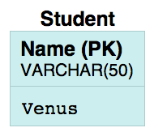
Example with constants
@prefix rr: <http://www.w3.org/ns/r2rml#> .
@prefix foaf: <http://xmlns.com/foaf/0.1/> .
@prefix ex: <http://example.com/> .
@prefix xsd: <http://www.w3.org/2001/XMLSchema#> .
@base <http://example.com/base/> .
<TriplesMap1>
a rr:TriplesMap;
rr:logicalTable [ rr:tableName "\"Student\"" ];
rr:subjectMap [ rr:constant ex:BadStudent ] ;
rr:predicateObjectMap
[
rr:predicateMap [ rr:constant ex:description ];
rr:objectMap [ rr:constant "Bad Student"; ]
]
.

Slide 12
Terms from a Column
A column-valued term map is a term map that is represented by a resource that has exactly one rr:column property.
The value of the rr:column property must be a valid column name. The column value of the term map is the data value of that column in a given logical table row.
The referenced columns of a column-valued term map is the singleton set containing the value of the term map's rr:column property.
The following example defines an object map that generates literals from the DNAME column of some logical table.
[] rr:objectMap [ rr:column "DNAME" ].

Slide 13
From template
A template-valued term map is a term map that is represented by a resource that has exactly one rr:template property. The value of the rr:template property must be a valid string template.
A string template is a format string that can be used to build strings from multiple components. It can reference column names by enclosing them in curly braces (“{” and “}”). The following syntax rules apply to valid string templates:
Pairs of unescaped curly braces must enclose valid column names.
Curly braces that do not enclose column names must be escaped by a backslash character (“\”). This also applies to curly braces within column names.
Backslash characters (“\”) must be escaped by preceding them with another backslash character, yielding “\\”. This also applies to backslashes within column names.
There should be at least one pair of unescaped curly braces.
If a template contains multiple pairs of unescaped curly braces, then any pair should be separated from the next one by a safe separator. This is any character or string that does not occur anywhere in any of the data values of either referenced column; or in the IRI-safe versions of the data values, if the term type is rr:IRI (see note below).

Slide 14
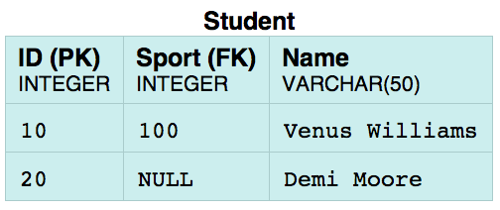
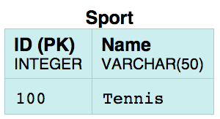
<TriplesMap2> a rr:TriplesMap;
rr:logicalTable [ rr:tableName "\"Sport\"" ];
rr:subjectMap [ rr:template "http://example.com/resource/sport_{\"ID\"}_{\"ID\"}""; ];
rr:predicateObjectMap
[
rr:predicate rdfs:label ; rr:objectMap [ rr:column "\"Name\""; ];
];
.
<TriplesMap2> a rr:TriplesMap;
rr:logicalTable [ rr:tableName "\"Sport\"" ];
rr:subjectMap [ rr:template "http://example.com/resource/sport_{\"ID\"}”{\"ID\"}"; ];
rr:predicateObjectMap
[
rr:predicate rdfs:label ; rr:objectMap [ rr:column "\"Name\""; ];
];
.

Slide 15
From template
The template value of the term map for a given logical table row is determined as follows:
Let result be the template string
For each pair of unescaped curly braces in result:
Let value be the data value of the column whose name is enclosed in the curly braces
If value is NULL, then return NULL
Let value be the natural RDF lexical form corresponding to value
If the term type is rr:IRI, then replace the pair of curly braces with an IRI-safe version of value; otherwise, replace the pair of curly braces with value
Return result
The IRI-safe version of a string is obtained by applying the following transformation to any character that is not in the iunreserved production in [RFC3987]:
Convert the character to a sequence of one or more octets using UTF-8 [RFC3629]
Percent-encode each octet [RFC3986]

Slide 16
Notes
R2RML always performs percent-encoding when IRIs are generated from string templates. If IRIs need to be generated without percent-encoding, then rr:column should be used instead of rr:template, with an R2RML view that performs the string concatenation.
In the case of string templates that generate IRIs, any single character that is legal in an IRI, but percent-encoded in the IRI-safe version of a data value, is a safe separator. This includes in particular the eleven sub-delim characters defined in [RFC3987]: !$&'()*+,;=

Slide 17
IRIs, Literal, Blank Nodes (rr:termType)
The term type of a column-valued term map or template-valued term map determines the kind of generated RDF term (IRIs, blank nodes or literals).
If the term map has an optional rr:termType property, then its term type is the value of that property. The value must be an IRI and must be one of the following options:
If the term map is a subject map: rr:IRI or rr:BlankNode
If the term map is a predicate map: rr:IRI
If the term map is an object map: rr:IRI, rr:BlankNode, or rr:Literal
If the term map is a graph map: rr:IRI

Slide 18
IRIs, Literal, Blank Nodes (rr:termType)
If the term map does not have a rr:termType property, then its term type is:
rr:Literal, if it is an object map and at least one of the following conditions is true:
It is a column-based term map.
It has a rr:language property (and thus a specified language tag).
It has a rr:datatype property (and thus a specified datatype).
rr:IRI, otherwise.

Slide 19
Example:
<TriplesMap1>
a rr:TriplesMap;
rr:logicalTable [ rr:sqlQuery """
SELECT ('Student' || "Student") AS StudentId,
"Student"
FROM "Student_Sport"
""";
] ;
rr:subjectMap [ rr:column "StudentId"; rr:termType rr:Literal;
rr:class ex:Student ];
rr:predicateObjectMap
[
rr:predicate foaf:name ;
rr:objectMap [ rr:column "\"Student\"" ]
]
.

Slide 20
IRIs, Literal, Blank Nodes (rr:termType)
Term maps with term type rr:IRI cause data errors if the value is not a valid IRI (see generated RDF term for details). Data values from the input database may require percent-encoding before they can be used in IRIs. Template-valued term maps are a convenient way of percent-encoding data values.
Constant-valued term maps are not considered as having a term type, and specifying rr:termType on these term maps has no effect. The type of the generated RDF term is determined directly by the value of rr:constant: If it is an IRI, then an IRI will be generated; if it is a literal, a literal will be generated.

Slide 21
Exercise: model as values
Patient | CancerType | Stage
Mary | Lung | 1

Slide 22
Exercise: model as objects
Patient | CancerType | Stage
Mary

Slide 23
Modeling as values vs. objects
Values:
Values allow for natural comparison and queries
DB style, easy to grasp by beginners
Complexity of the data is low
Objects
Expressivity high
Data can be closer to the original conceptual model
Possibility to apply hierarchies and reasoning over objects

Slide 24
Language Tags (rr:language)
A term map with a term type of rr:Literal may have a specified language tag. It is represented by the rr:language property on a term map. If present, its value must be a valid language tag.
A specified language tag causes generated literals to be language-tagged plain literals

Slide 25
Example
<TriplesMap1>
a rr:TriplesMap;
rr:logicalTable [ rr:sqlQuery """
SELECT "Code", "Name", "Lan"
FROM "Country"
WHERE "Lan" = 'EN';
""" ] ;
rr:subjectMap [ rr:template "http://example.com/{\"Code\"}" ];
rr:predicateObjectMap
[
rr:predicate rdfs:label;
rr:objectMap [ rr:column "\"Name\""; rr:language "english" ]
]
.

Slide 26
Typed Literals (rr:datatype)
A datatypeable term map is a term map with a term type of rr:Literal that does not have a specified language tag.
Datatypeable term maps may generate typed literals. The datatype of these literals can be automatically determined based on the SQL datatype of the underlying logical table column (producing a natural RDF literal), or it can be explicitly overridden using rr:datatype (producing a datatype-override RDF literal).
A datatypeable term map may have a rr:datatype property. Its value must be an IRI. This IRI is the specified datatype of the term map.
A term map must not have more than one rr:datatype value.
A term map that is not a datatypeable term map must not have an rr:datatype property.

Slide 27
Typed Literals (rr:datatype)
The implicit SQL datatype of a datatypeable term map is CHARACTER VARYING if the term map is a template-valued term map; otherwise, it is the SQL datatype of the respective column in the logical table row.
See generated RDF term for further details on generating literals from term maps.
One cannot explicitly state that a plain literal without language tag should be generated. They are the default for string columns. To generate one from a non-string column, a template-valued term map with a template such as "{MY_COLUMN}" and a term type of rr:Literal can be used.

Slide 28
Example
<TriplesMap1>
a rr:TriplesMap;
rr:logicalTable [ rr:sqlQuery """
Select ('Department' || "deptno") AS deptId
, "deptno"
, "dname"
, "loc"
from "DEPT"
""" ];
rr:subjectMap [ rr:column "deptId"; rr:termType rr:BlankNode;
rr:inverseExpression "{\"deptno\"} = substr({deptId},length('Department')+1)"];
rr:predicateObjectMap
[
rr:predicate dept:deptno ;
rr:objectMap [ rr:column "\"deptno\""; rr:datatype xsd:positiveInteger ]
];

Slide 29
Inverse Expressions (rr:inverseExpression)
An inverse expression is a string template associated with a column-valued term map or template-value term map. It is represented by the value of the rr:inverseExpression property. This property is optional and there must not be more than one for a term map.
Inverse expressions are useful for optimizing term maps that reference derived columns in R2RML views. An inverse expression specifies an expression that allows “reversing” of a generated RDF term and the construction of a SQL query that efficiently retrieves the logical table row from which the term was generated. In particular, it allows the use of indexes on the underlying relational tables.
Every pair of unescaped curly braces in the inverse expression is a column reference in an inverse expression. The string between the braces must be a valid column name.

Slide 30
Example
<TriplesMap1>
a rr:TriplesMap;
rr:logicalTable [ rr:sqlQuery """
SELECT ('Department' || "deptno") AS "deptId"
, "deptno” , "dname"
, "loc"
FROM "DEPT"
""" ];
rr:subjectMap [ rr:column "\"deptId\""; rr:termType rr:BlankNode;
rr:inverseExpression "{\"deptno\"} = substr({\"deptId\"},length('Department')+1)"];
rr:predicateObjectMap
[
rr:predicate dept:location ;
rr:objectMap [ rr:column "\"loc\"" ]
];
.

Slide 31
Example
The following table states distances in kilometers, generate RDF that presents this data in miles, add an inverse map that allows to reverse (1km = 0,62 mi).
city1 | city2 | distance
bolzano | munich | 278,4

Slide 32
Foreign Key Relationships among Logical Tables
A referencing object map allows using the subjects of another triples map as the objects generated by a predicate-object map. Since both triples maps may be based on different logical tables, this may require a join between the logical tables. This is not restricted to 1:1 joins.
A referencing object map is represented by a resource that:
has exactly one rr:parentTriplesMap property, whose value must be a triples map, known as the referencing object map's parent triples map.
may have one or more rr:joinCondition properties, whose values must be join conditions.

Slide 33
Foreign Key Relationships among Logical Tables
A join condition is represented by a resource that has exactly one value for each of the following two properties:
rr:child, whose value is known as the join condition's child column and must be a column name that exists in the logical table of the triples map that contains the referencing object map
rr:parent, whose value is known as the join condition's parent column and must be a column name that exists in the logical table of the referencing object map's parent triples map.
The child query of a referencing object map is the effective SQL query of the logical table of the term map containing the referencing object map.
The parent query of a referencing object map is the effective SQL query of the logical table of its parent triples map.

Slide 34
Foreign Key Relationships among Logical Tables
The joint SQL query of a referencing object map is:
If the referencing object map has no join condition: SELECT * FROM ({child-query}) AS tmp
If the referencing object map has at least one join condition: SELECT * FROM ({child-query}) AS child, ({parent-query}) AS parent WHERE child.{child-column1}=parent.{parent-column1} AND child.{child-column2}=parent.{parent-column2} AND ...
where {child-query} is the referencing object map's child query, {parent-query} is its parent query, {child-column1} and {parent-column1} are the child column and parent column of its first join condition, and so on. The order of the join conditions is chosen arbitrarily.
The joint SQL query is used when generating RDF triples from referencing object maps.

Slide 35
Assigning Triples to Named Graphs
Each triple generated from an R2RML mapping is placed into one or more graphs of the output dataset. Possible target graphs are the unnamed default graph, and the IRI-named named graphs.
Any subject map or predicate-object map may have one or more associated graph maps. They are specified in one of two ways:
using the rr:graphMap property, whose value must be a graph map,
using the constant shortcut property rr:graph.
Graph maps are themselves term maps. When RDF triples are generated, the set of target graphs is determined by taking into account any graph maps associated with the subject map or predicate-object map.
If a graph map generates the special IRI rr:defaultGraph, then the target graph is the default graph of the output dataset.

Slide 36
In the following subject map example, all generated RDF triples will be stored in the named graph ex:DepartmentGraph.
This is equivalent to the following example, which uses a constant shortcut property:
[] rr:subjectMap [
rr:template "http://data.example.com/department/{DEPTNO}";
rr:graphMap [ rr:constant ex:DepartmentGraph ];
].
[] rr:subjectMap [
rr:template "http://data.example.com/department/{DEPTNO}";
rr:graph ex:DepartmentGraph;
].

Slide 37
In the following example, RDF triples are placed into named graphs according to the job title of employees:
This is equivalent to the following example, which uses a constant shortcut property:
[] rr:subjectMap [
rr:template "http://data.example.com/employee/{EMPNO}";
rr:graphMap [ rr:template "http://data.example.com/jobgraph/{JOB}" ];
].
<http://data.example.com/jobgraph/CLERK>

Slide 38
Detailed Specification
Books Example
Tools

Slide 39
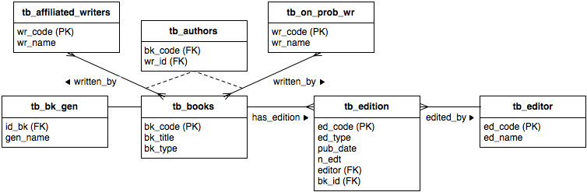
Books DB
Propose a Class/Property vocabulary
Propose a URI scheme for each entity type
Define an R2RML mapping and an OWL ontology such that a) the number of mappings is minimal, b) data is correctly typed c) language and type are specified when necessary
Genre
Fiction
Horror
Mystery
Fantasy
Romance
Biography
…
Book types
A = Audio Book
E = E-Book
P = Paper back
Edition type
S = Special/Limited

Slide 40
SPARQL Target queries
The ontology/mappings should allow for easy (preferably avoiding UNION) querying for the following data:
RE-001: Query for all the author names (22 tuples)
RE-002: Query for all the book titles (24 tuples).
RE-003: Query for all the editor names (11 tuples).
RE-004: Query for all the titles that all audio books.
RE-005: Query for all the names for all authors that are an emerging writer.
RE-006: Query for all the dates of publication and edition numbers of books that are special editions.
RE-007: Query for all the book titles written by a specific author.
RE-008: Query for the complete information about a book, including its author, genre, publication date and edition number.

Slide 41
Detailed Specification
Books Example
Tools

Slide 42
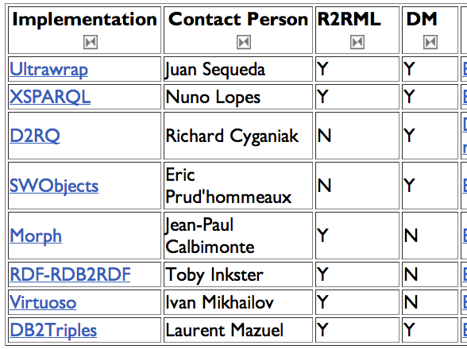
Implementations

