Slide 1
R2RML: RDB to RDF Mapping Language
Werner Nutt

Slide 2
Acknowledgment
These slides are based on a slide set by Mariano Rodriguez

Slide 3
Reading Material/Sources
R2RML specification by W3C http://www.w3.org/TR/r2rml/
R2RML specification byW3C http://www.w3.org/2001/sw/rdb2rdf/test-cases/

Slide 4
Standards and Tools
Mapping languages
Standards by RDB2RDF working group (W3C)
Direct Mapping
R2RML
Proprietary
Tools
Free: D2R, Virtuoso, Morph, r2rml4net, db2triples, ultrawrap, Quest
Commercial: Virtuoso, ultrawrap, Oracle SW

Slide 5
Overview and Examples
Detailed Specification

Slide 6
Overview and Examples
Detailed Specification

Slide 7
R2RML Overview
R2RML is a language for specifying mappings from relational to RDF data.
A mapping takes as input a logical table, i.e.,
a database table
a database view, or
an SQL query (called an “R2RML view” because it is like an SQL view but does not modify the database)
A logical table is mapped to a set of triples by a rule called
triples map.

Slide 8
Triples Maps
A triples map has two parts:
a subject map
several predicate-object maps (combining predicate and object maps).
Input of a map:
a row of the logical table
Output of a map: for each row,
a subject resource (IRI or blank node), often generated from primary key values
several triples with the same subject, but varying predicates and objects, generated from the attributes of the row

Slide 9
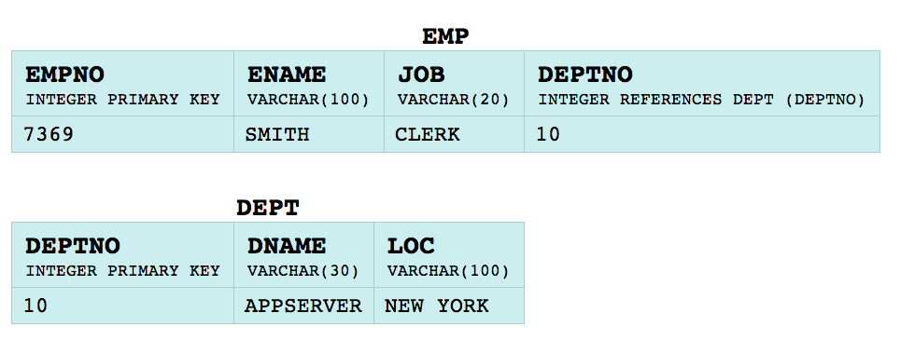
Triples Maps (cntd)
Idea: triples are produced by:
subject maps
predicate maps
object maps.
Example
The subject IRI is generated from the empno column by the template
http://data.example.com/employee/{empno}
The predicate IRI is the constant ex:name
The object is the literal "SMITH”, that is copied from the ENAME column

Slide 10
Output Graph
By default, all RDF triples are in the default graph of the output dataset.
A triples map can contain graph maps that place some or all of the triples into named graphs instead.

Slide 11
Example
Relational tables
Set of RDF triples
<http://data.example.com/employee/7369> rdf:type ex:Employee.
<http://data.example.com/employee/7369> ex:name "SMITH".
<http://data.example.com/employee/7369> ex:department <http://data.example.com/department/10>.
<http://data.example.com/department/10> rdf:type ex:Department.
<http://data.example.com/department/10> ex:name "APPSERVER".
<http://data.example.com/department/10> ex:location "NEW YORK".
<http://data.example.com/department/10> ex:staff 1.

Slide 12
Features of the Example
<http://data.example.com/employee/7369> rdf:type ex:Employee.
<http://data.example.com/employee/7369> ex:name "SMITH".
<http://data.example.com/employee/7369> ex:department <http://data.example.com/department/10>.
<http://data.example.com/department/10> rdf:type ex:Department.
<http://data.example.com/department/10> ex:name "APPSERVER".
<http://data.example.com/department/10> ex:location "NEW YORK".
<http://data.example.com/department/10> ex:staff 1.
Subjects are instances of classes from a general vocabulary
Properties are from the same general vocabulary
IRIs contain neither table nor column names
The foreign key from EMP to DEPT is translated into a single property (no duplication into value and reference)
The department resource has an additional property ex:staff, which contains the number of employees of the department

Slide 13
Mapping a Table
Result
<http://data.example.com/employee/7369> rdf:type ex:Employee.
<http://data.example.com/employee/7369> ex:name "SMITH".
<http://data.example.com/employee/7369> ex:department <http://data.example.com/department/10>.
<http://data.example.com/department/10> rdf:type ex:Department.
<http://data.example.com/department/10> ex:name "APPSERVER".
<http://data.example.com/department/10> ex:location "NEW YORK".
<http://data.example.com/department/10> ex:staff 1.
@prefix rr: <http://www.w3.org/ns/r2rml#>.
@prefix ex: <http://example.com/ns#>.
<#TriplesMap1>
rr:logicalTable [ rr:tableName "EMP" ];
rr:subjectMap [
rr:template "http://data.example.com/employee/{EMPNO}";
rr:class ex:Employee;
];
rr:predicateObjectMap [
rr:predicate ex:name;
rr:objectMap [ rr:column "ENAME" ];
].

Slide 14
R2RML Views
<http://data.example.com/employee/7369> rdf:type ex:Employee.
<http://data.example.com/employee/7369> ex:name "SMITH".
<http://data.example.com/employee/7369> ex:department <http://data.example.com/department/10>.
<http://data.example.com/department/10> rdf:type ex:Department.
<http://data.example.com/department/10> ex:name "APPSERVER".
<http://data.example.com/department/10> ex:location "NEW YORK".
<http://data.example.com/department/10> ex:staff 1.
Pay attention to the triple quotes:
needed for literals with linebreaks
<#DeptTableView> rr:sqlQuery """
SELECT DEPTNO,
DNAME,
LOC,
(SELECT COUNT(*) FROM EMP WHERE EMP.DEPTNO=DEPT.DEPTNO) AS STAFF
FROM DEPT;
""".
View definition

Slide 15
Views
Result
<http://data.example.com/employee/7369> rdf:type ex:Employee.
<http://data.example.com/employee/7369> ex:name "SMITH".
<http://data.example.com/employee/7369> ex:department <http://data.example.com/department/10>.
<http://data.example.com/department/10> rdf:type ex:Department.
<http://data.example.com/department/10> ex:name "APPSERVER".
<http://data.example.com/department/10> ex:location "NEW YORK".
<http://data.example.com/department/10> ex:staff 1.
<#TriplesMap2>
rr:logicalTable <#DeptTableView>;
rr:subjectMap [
rr:template "http://data.example.com/department/{DEPTNO}";
rr:class ex:Department;
];
rr:predicateObjectMap [
rr:predicate ex:name;
rr:objectMap [ rr:column "DNAME" ];
];
rr:predicateObjectMap [
rr:predicate ex:location;
rr:objectMap [ rr:column "LOC" ];
];
rr:predicateObjectMap [
rr:predicate ex:staff;
rr:objectMap [ rr:column "STAFF" ];
].
Mapping to a View Definition

Slide 16
Linking Two Logical Tables
Result
<http://data.example.com/employee/7369> rdf:type ex:Employee.
<http://data.example.com/employee/7369> ex:name "SMITH".
<http://data.example.com/employee/7369> ex:department <http://data.example.com/department/10>.
<http://data.example.com/department/10> rdf:type ex:Department.
<http://data.example.com/department/10> ex:name "APPSERVER".
<http://data.example.com/department/10> ex:location "NEW YORK".
<http://data.example.com/department/10> ex:staff 1.
<#TriplesMap1>
rr:predicateObjectMap [
rr:predicate ex:department;
rr:objectMap [
rr:parentTriplesMap <#TriplesMap2>;
rr:joinCondition [
rr:child "DEPTNO";
rr:parent "DEPTNO";
];
];
].

Slide 17
Linking Two Logical Tables: Features
Additonal predicate object map for <#TriplesMap1>
Object map retrieves subject from parent triples map by joining along a foreign key relationship
It joins
the current row of the logical table
with the row of the logical table of <#TriplesMap1> that satisfies the join condition
Note:
child = referencing map
parent = referenced map
<#TriplesMap1>
rr:predicateObjectMap [
rr:predicate ex:department;
rr:objectMap [
rr:parentTriplesMap <#TriplesMap2>;
rr:joinCondition [
rr:child "DEPTNO";
rr:parent "DEPTNO";
];
];
].

Slide 18
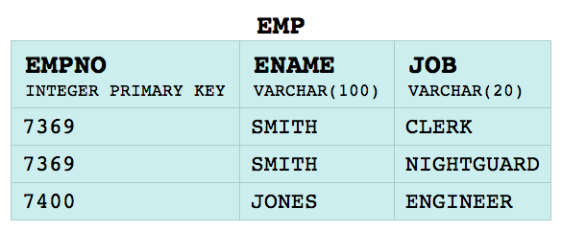
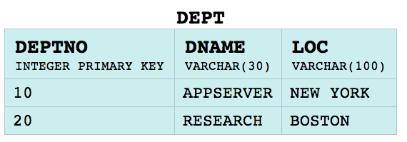
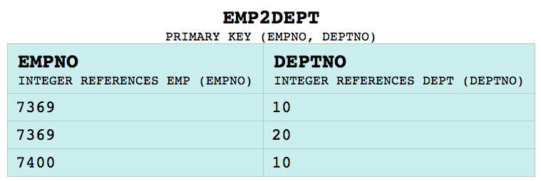
Many to Many Relationship: Approach 1
Direct mapping style output
<http://data.example.com/employee=7369/department=10>
ex:employee <http://data.example.com/employee/7369> ;
ex:department <http://data.example.com/department/10> .
<http://data.example.com/employee=7369/department=20>
ex:employee <http://data.example.com/employee/7369> ;
ex:department <http://data.example.com/department/20> .
<http://data.example.com/employee=7400/department=10>
ex:employee <http://data.example.com/employee/7400> ;
ex:department <http://data.example.com/department/10> .

Slide 19
Many to Many Relationship: Approach 1
<http://data.example.com/employee=7369/department=10>
ex:employee <http://data.example.com/employee/7369> ;
ex:department <http://data.example.com/department/10> .
<#TriplesMap3>
rr:logicalTable [ rr:tableName "EMP2DEPT" ];
rr:subjectMap [ rr:template "http://data.example.com/employee={EMPNO}/department={DEPTNO}" ];
rr:predicateObjectMap [
rr:predicate ex:employee;
rr:objectMap [ rr:template "http://data.example.com/employee/{EMPNO}" ];
];
rr:predicateObjectMap [
rr:predicate ex:department;
rr:objectMap [ rr:template "http://data.example.com/department/{DEPTNO}" ];
].
The mapping

Slide 20
Many to Many Relationship: Approach 1
<http://data.example.com/employee=7369/department=10>
ex:employee <http://data.example.com/employee/7369> ;
ex:department <http://data.example.com/department/10> .
Note: this models the case where the subject identifies each row (composite)
<#TriplesMap3>
rr:logicalTable [ rr:tableName "EMP2DEPT" ];
rr:subjectMap [ rr:template "http://data.example.com/employee={EMPNO}/department={DEPTNO}" ];
rr:predicateObjectMap [
rr:predicate ex:employee;
rr:objectMap [ rr:template "http://data.example.com/employee/{EMPNO}" ];
];
rr:predicateObjectMap [
rr:predicate ex:department;
rr:objectMap [ rr:template "http://data.example.com/department/{DEPTNO}" ];
].
The mapping

Slide 21
Many to Many Relationship: Approach 2
Expected output
<http://data.example.com/employee/7369>
ex:department <http://data.example.com/department/10> ;
ex:department <http://data.example.com/department/20> .
<http://data.example.com/employee/7400>
ex:department <http://data.example.com/department/10>.

Slide 22
Many to Many Relationship: Approach 2
<http://data.example.com/employee/7369>
ex:department <http://data.example.com/department/10> ;
ex:department <http://data.example.com/department/20> .
<http://data.example.com/employee/7400>
ex:department <http://data.example.com/department/10>.
<#TriplesMap3>
rr:logicalTable [ rr:tableName "EMP2DEPT" ];
rr:subjectMap [
rr:template "http://data.example.com/employee/{EMPNO}";
];
rr:predicateObjectMap [
rr:predicate ex:department;
rr:objectMap [ rr:template "http://data.example.com/department/{DEPTNO}" ];
].
The mapping

Slide 23
Many to Many Relationship: Approach 2
<http://data.example.com/employee/7369>
ex:department <http://data.example.com/department/10> ;
ex:department <http://data.example.com/department/20> .
<http://data.example.com/employee/7400>
ex:department <http://data.example.com/department/10>.
<#TriplesMap3>
rr:logicalTable [ rr:tableName "EMP2DEPT" ];
rr:subjectMap [
rr:template "http://data.example.com/employee/{EMPNO}";
];
rr:predicateObjectMap [
rr:predicate ex:department;
rr:objectMap [ rr:template "http://data.example.com/department/{DEPTNO}" ];
].
The mapping

Slide 24
Translating Job Codes to IRIs
Assume the following correspondance:
CLERK http://data.example.com/roles/general-office
NIGHTGUARD http://data.example.com/roles/security
ENGINEER http://data.example.com/roles/engineering
<http://data.example.com/employee/7369> ex:role
<http://data.example.com/roles/general-office>.

Slide 25
Translating Job Codes to IRIs
<#TriplesMap1>
rr:logicalTable [ rr:sqlQuery
"""
SELECT EMP.*, (CASE JOB
WHEN 'CLERK' THEN 'general-office'
WHEN 'NIGHTGUARD' THEN 'security'
WHEN 'ENGINEER' THEN 'engineering'
END) AS ROLE FROM EMP
""" ];
rr:subjectMap [
rr:template "http://data.example.com/employee/{EMPNO}";
];
rr:predicateObjectMap [
rr:predicate ex:role;
rr:objectMap [ rr:template "http://data.example.com/roles/{ROLE}" ];
].

Slide 26
Overview and Examples
Detailed Specification

Slide 27
R2RML Processors and Mapping Documents
An R2RML mapping
defines a mapping from a relational database to RDF
consists of one or more triples maps.
The input is called the input database.
An R2RML processor,
given an R2RML mapping and an input database, provides access to the output dataset;
has access to an execution environment with: - an SQL connection to the input database, - a base IRI
An R2RML processor may include an R2RML data validator

Slide 28
Data Errors
The RDF data produced by a mapping may be erroneous, due to the format and type of the data in the database.
Two cases:
The map produces a term of type rr:IRI, but the term is not a valid IRI
The map is intended to produce a literal, but the mapping specifies a datatype that overrides the natural RDF data type (there is a specific correspondence between SQL and RDF datatypes)

Slide 29
Data Errors
The RDF data produced by a mapping may be erroneous, due to the format and type of the data in the database.
Two cases:
The map produces a term of type rr:IRI, but the term is not a valid IRI
The map is intended to produce a literal, but the mapping specifies a datatype that overrides the natural RDF data type (there is a specific correspondence between SQL and RDF datatypes)
Data errors cannot generally be detected by analyzing the table schema of the database, but only by scanning the data in the tables. For large and rapidly changing databases, this can be impractical. Therefore, R2RML processors are allowed to answer queries that do not “touch” a data error, and the behavior of such operations is well-defined. For the same reason, the conformance of R2RML mappings is defined without regard for the presence of data errors.
Source: R2RML: RDB to RDF Mapping Language
W3C Recommendation

Slide 30
Direct Mapping as Default Mappings
An R2RML processor may include an R2RML default mapping generator
Output: Direct Graph corresponding to the input database (Direct Mapping).
No duplicate row preservation: For tables without a primary key, the Direct Graph requires that a fresh blank node is created for each row. This ensures that duplicate rows in such tables are preserved. This requirement is relaxed for R2RML default mappings: They may reuse the same blank node for multiple duplicate rows. This behavior does not preserve duplicate rows.

Slide 31
Logical Tables
A logical table is a tabular SQL query result that is to be mapped to RDF triples. It is either
a SQL base table or view, or
an R2RML view.
Every logical table has an effective SQL query
if executed over the SQL connection, it produces the contents of the logical table

Slide 32
Base Tables and SQL Views (rr:tableName)
A SQL base table or view is a logical table containing SQL data from a base table or view in the input database. A SQL base table or view is represented by a resource that has exactly one rr:tableName property. The value of rr:tableName specifies the table or view name of the base table or view. Its value must be a valid schema-qualified name that names an existing base table or view in the input database.
The effective SQL query of a SQL base table or view is: SELECT * FROM {table}

Slide 33
Example of Mapping from a Base Table
@prefix rr: <http://www.w3.org/ns/r2rml#>.
@prefix ex: <http://example.com/ns#>.
<#TriplesMap1>
rr:logicalTable [ rr:tableName "EMP" ];
rr:subjectMap [
rr:template "http://data.example.com/employee/{EMPNO}";
rr:class ex:Employee;
];
rr:predicateObjectMap [
rr:predicate ex:name;
rr:objectMap [ rr:column "ENAME" ];
].

Slide 34
R2RML Views (rr:sqlQuery, rr:sqlVersion)
An R2RML view is a logical table whose contents are the result of executing a SQL query against the input database.
It is represented by a resource that has exactly one rr:sqlQuery property, whose value is a literal with a lexical form that is a valid SQL query.
Data transformation
R2RML mappings sometimes require data transformation, computation, or filtering before generating triples from the database.
This can be achieved by defining a SQL view in the input database and referring to it with rr:tableName.
However, this approach may sometimes not be practical for lack of database privileges or other reasons.
R2RML views achieve the same effect without requiring changes to the input database.

Slide 35
R2RML Views (rr:sqlQuery)
No duplicated columns allowed: SELECT EMP.DEPTNO, 1 AS DEPTNO FROM EMP;
Unnamed columns are not recommended SELECT DEPTNO, COUNT(EMPNO) FROM EMP GROUP BY DEPTNO;

Slide 36
Example of Mapping from View
<#DeptTableView> rr:sqlQuery """
SELECT DEPTNO,
DNAME,
LOC,
(SELECT COUNT(*) FROM EMP WHERE EMP.DEPTNO=DEPT.DEPTNO) AS STAFF
FROM DEPT;
""".
<#TriplesMap2>
rr:logicalTable <#DeptTableView>;
rr:subjectMap [
rr:template "http://data.example.com/department/{DEPTNO}";
rr:class ex:Department;
];
rr:predicateObjectMap [
rr:predicate ex:name;
rr:objectMap [ rr:column "DNAME" ];
];
rr:predicateObjectMap [
rr:predicate ex:staff;
rr:objectMap [ rr:column "STAFF" ];
].

Slide 37
Version Identifiers (rr:sqlVersion)
An R2RML view may have one or more SQL version identifiers. They must be valid IRIs and are represented as values of the rr:sqlVersion property. The following SQL version identifier indicates that the SQL query conforms to Core SQL 2008: http://www.w3.org/ns/r2rml#SQL2008
The absence of a SQL version identifier indicates that no claim to Core SQL 2008 conformance is made.
Additional identifiers, not normative, an be found at: http://www.w3.org/2001/sw/wiki/RDB2RDF/SQL_Version_IRIs

Slide 38
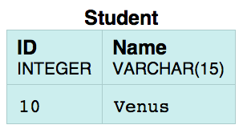
Example
Pay attention to SQL identifiers in double quotes:
“delimited” identifiers
@prefix rr: <http://www.w3.org/ns/r2rml#> .
@prefix foaf: <http://xmlns.com/foaf/0.1/> .
@prefix ex: <http://example.com/> .
@prefix xsd: <http://www.w3.org/2001/XMLSchema#> .
@base <http://example.com/base/> .
<TriplesMap1>
a rr:TriplesMap;
rr:logicalTable [
rr:sqlQuery """
SELECT "ID”, "Name” FROM "Student" """;
rr:sqlVersion rr:SQL2008
];
rr:subjectMap [ rr:template "http://example.com/{\"ID\"}/{\"Name\"}"; ];
rr:predicateObjectMap
[
rr:predicate foaf:name ;
rr:objectMap [ rr:column "\"Name\"" ]
]
.
Pay attention to the backslash quotes:
escape characters in “flat” literals

Slide 40
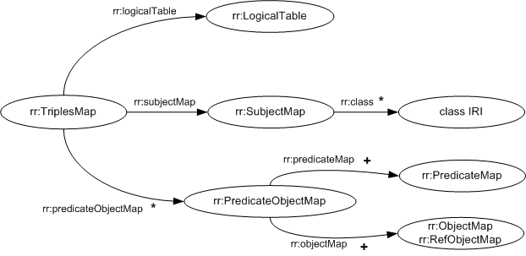
Mapping Logical Tables to RDF with Triples Maps
A triples map specifies a rule for translating each row of a logical table to zero or more RDF triples.

Slide 41
Mapping Logical Tables to RDF with Triples Maps
The RDF triples generated from one row in the logical table all share the same subject.
A triples map is represented by a resource that references the following other resources:
It must have exactly one rr:logicalTable property. Its value is a logical table that specifies a SQL query result to be mapped to triples.
It must have exactly one subject map that specifies how to generate a subject for each row of the logical table. It may be specified in two ways:
using the rr:subjectMap property, whose value must be the subject map, or
using the constant shortcut property rr:subject.
It may have zero or more rr:predicateObjectMap properties, whose values must be predicate-object maps. They specify pairs of predicate maps and object maps that, together with the subjects generated by the subject map, may form one or more RDF triples for each row.

Slide 42
Mapping Logical Tables to RDF with Triples Maps
[]
rr:logicalTable [ rr:tableName "DEPT" ];
rr:subjectMap [ rr:template "http://data.example.com/department/{DEPTNO}" ];
rr:predicateObjectMap [
rr:predicate ex:name;
rr:objectMap [ rr:column "DNAME" ];
];
rr:predicateObjectMap [
rr:predicate ex:location;
rr:objectMap [ rr:column "LOC" ];
].

Slide 43
Mapping Logical Tables to RDF with Triples Maps
@prefix rr: <http://www.w3.org/ns/r2rml#>.
@prefix ex: <http://example.com/ns#>.
<#TriplesMap1>
rr:logicalTable [ rr:tableName "EMP" ];
rr:subjectMap [
rr:template "http://data.example.com/employee/{EMPNO}";
rr:class ex:Employee;
];
rr:predicateObjectMap [
rr:predicate ex:name;
rr:objectMap [ rr:column "ENAME" ];
].

Slide 44
Creating Resources with Subject Maps
A subject map is a term map. It specifies a rule for generating the subjects of the RDF triples generated by a triples map.
Term maps are used to generate the subjects, predicates and objects of the RDF triples that are generated by a triples map. Consequently, there are several kinds of term maps, depending on where in the mapping they occur: subject maps, predicate maps, object maps and graph maps.
A term map must be exactly one of the following:
a constant-valued term map,
a column-valued term map,
a template-valued term map.

Slide 45
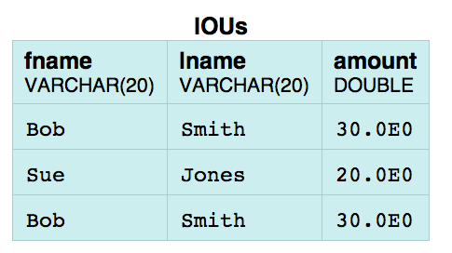
Example with Template
@prefix rr: <http://www.w3.org/ns/r2rml#> .
@prefix foaf: <http://xmlns.com/foaf/0.1/> .
@prefix ex: <http://example.com/> .
@prefix xsd: <http://www.w3.org/2001/XMLSchema#> .
@base <http://example.com/base/> .
<TriplesMap1>
a rr:TriplesMap;
rr:logicalTable [ rr:tableName "\"IOUs\"" ];
rr:subjectMap [ rr:template "http://example.com/{\"fname\"};{\"lname\"}";
rr:class foaf:Person ];
rr:predicateObjectMap
[
rr:predicate ex:owes ;
rr:objectMap [ rr:column "\"amount\""; ]
];
.

Slide 47
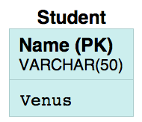
Example with constants
@prefix rr: <http://www.w3.org/ns/r2rml#> .
@prefix foaf: <http://xmlns.com/foaf/0.1/> .
@prefix ex: <http://example.com/> .
@prefix xsd: <http://www.w3.org/2001/XMLSchema#> .
@base <http://example.com/base/> .
<TriplesMap1>
a rr:TriplesMap;
rr:logicalTable [ rr:tableName "\"Student\"" ];
rr:subjectMap [ rr:constant ex:BadStudent ] ;
rr:predicateObjectMap
[
rr:predicateMap [ rr:constant ex:description ];
rr:objectMap [ rr:constant "Bad Student"; ]
]
.

Slide 49
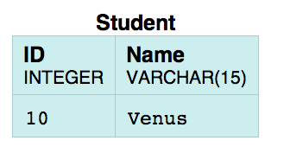
Creating Resources with Subject Maps
<TriplesMap1>
a rr:TriplesMap;
rr:logicalTable [
rr:sqlQuery "””
Select ('Student' || "ID" ) AS StudentId , "ID”, "Name”
From "Student"
""” ];
rr:subjectMap [ rr:column "StudentId"; rr:termType rr:BlankNode; ];
rr:predicateObjectMap
[
rr:predicate foaf:name ;
rr:objectMap [ rr:column "\"Name\"" ]
]
.

Slide 51
Creating Properties and Values with Predicate-Object Maps
A predicate-object map is a function that creates one or more predicate-object pairs for each logical table row of a logical table.
It is used in conjunction with a subject map to generate RDF triples in a triples map.

Slide 52
Creating Properties and Values with Predicate-Object Maps
A predicate-object map is represented by a resource that references the following other resources:
One or more predicate maps. Each of them may be specified in one of two ways:
using the rr:predicateMap property, whose value must be a predicate map, or
using the constant shortcut property rr:predicate.
One or more object maps or referencing object maps. Each of them may be specified in one of two ways:
using the rr:objectMap property, whose value must be either an object map, or a referencing object map.
using the constant shortcut property rr:object.
A predicate map is a term map.
An object map is a term map.

Slide 53
Example with Constants
@prefix rr: <http://www.w3.org/ns/r2rml#> .
@prefix foaf: <http://xmlns.com/foaf/0.1/> .
@prefix ex: <http://example.com/> .
@prefix xsd: <http://www.w3.org/2001/XMLSchema#> .
@base <http://example.com/base/> .
<TriplesMap1>
a rr:TriplesMap;
rr:logicalTable [ rr:tableName "\"Student\"" ];
rr:subjectMap [ rr:constant ex:BadStudent ] ;
rr:predicateObjectMap
[
rr:predicateMap [ rr:constant ex:description ];
rr:objectMap [ rr:constant "Bad Student"; ]
]
.

Slide 54
Example with Shortcuts
<TriplesMap1>
a rr:TriplesMap;
rr:logicalTable [ rr:tableName "\"Student\""; ];
rr:subjectMap [ rr:template "http://example.com/Student/{\"ID\"}/{\"Name\"}";
rr:graph ex:PersonGraph;
];
rr:predicateObjectMap
[
rr:predicate rdf:type;
rr:object foaf:Person;
];
rr:predicateObjectMap
[
rr:predicate foaf:name;
rr:objectMap [ rr:column "\"Name\"" ]
]

Slide 55
Creating Properties and Values with Predicate-Object Maps
A referencing object map allows using the subjects of another triples map as the objects generated by a predicate-object map. Since both triples maps may be based on different logical tables, this may require a join between the logical tables. This is not restricted to 1:1 joins.
A referencing object map is represented by a resource that:
has exactly one rr:parentTriplesMap property, whose value must be a triples map, known as the referencing object map's parent triples map.
may have one or more rr:joinCondition properties, whose values must be join conditions.
A join condition is represented by a resource that has exactly one value for each of the following two properties:
rr:child, whose value is known as the join condition's child column and must be a column name that exists in the logical table of the triples map that contains the referencing object map
rr:parent, whose value is known as the join condition's parent column and must be a column name that exists in the logical table of the referencing object map's parent triples map.

Slide 56
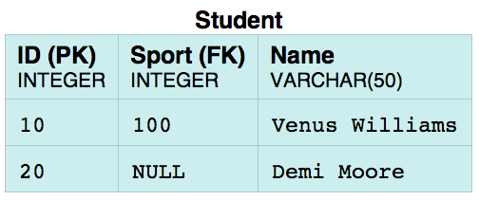
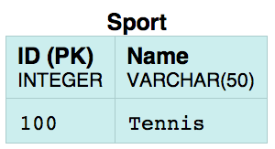
<TriplesMap1> a rr:TriplesMap;
rr:logicalTable [ rr:tableName "\"Student\"" ];
rr:subjectMap [ rr:template "http://example.com/resource/student_{\"ID\"}"; ];
rr:predicateObjectMap
[
rr:predicate foaf:name ; rr:objectMap [ rr:column "\"Name\""; ];
];
rr:predicateObjectMap
[
rr:predicate <http://example.com/ontology/practises> ;
rr:objectMap [
a rr:RefObjectMap ; rr:parentTriplesMap <TriplesMap2>;
rr:joinCondition [ rr:child "\"Sport\"" ; rr:parent "\"ID\"" ; ]
];
];
.
<TriplesMap2> a rr:TriplesMap;
rr:logicalTable [ rr:tableName "\"Sport\"" ];
rr:subjectMap [ rr:template "http://example.com/resource/sport_{\"ID\"}"; ];
rr:predicateObjectMap
[
rr:predicate rdfs:label ; rr:objectMap [ rr:column "\"Name\""; ];
];
.

