Slide 1
Introduction
Werner Nutt

Slide 2
Acknowledgment
These slides are based on the slide sets
RDF by Mariano Rodriguez
Overview and XML for the course Semantic Web Technologies at TU Dresden by Sebastian Rudolph

Slide 3
The Semantic Web Idea
Semantic Technologies

Slide 4
The Semantic Web Idea
Semantic Technologies

Slide 5
The Web
All aspects of daily life are being “webized”:
everyday information (news, weather forecast)
entertainment
buying and selling
administration (eGovernment)
education (eLearning, eEducation)
social contacts (social networking platforms, dating sites)

Slide 6
Why Semantic Web?
Syntax vs. Semantics
“4+) = (“ syntactically wrong, semantically …
“3 + 4 = 12” syntactically correct, semantically wrong
“3 + 4 = 7” syntactically correct, semantically correct
Syntax
Semantics
(from greek συνταξις composition,sentential structure) denotes the (normative) structure of data, i.e., it characterizes what makes data “well-formed”
(greek σημαυτικoς belonging to the sign) denotes the meaning of data, i.e., it characterizes what conclusions can be drawn from it

Slide 7
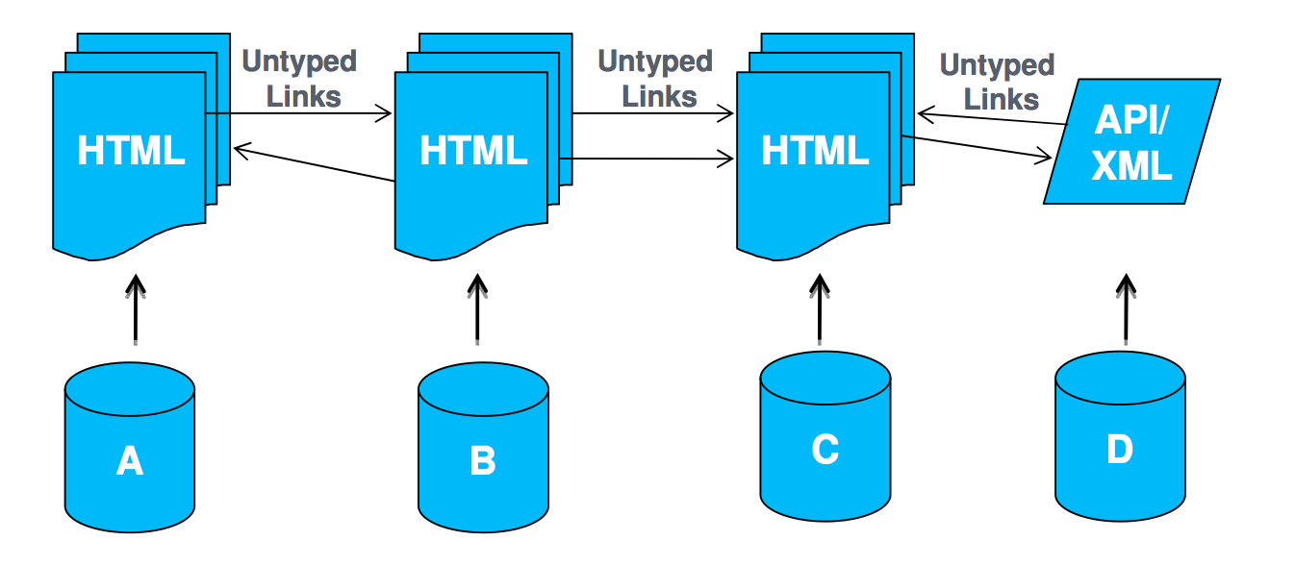
Web of Documents
Primary objects: documents Links between documents
Degree of structure in data: low
Semantics of content: implicit
Designed for: human consumption

Slide 8
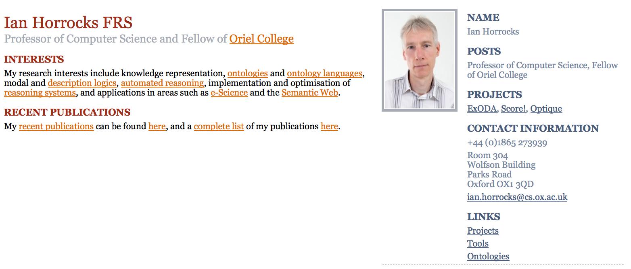
Problems of the Web of Documents
wealth of information
… targeted at human users

Slide 9
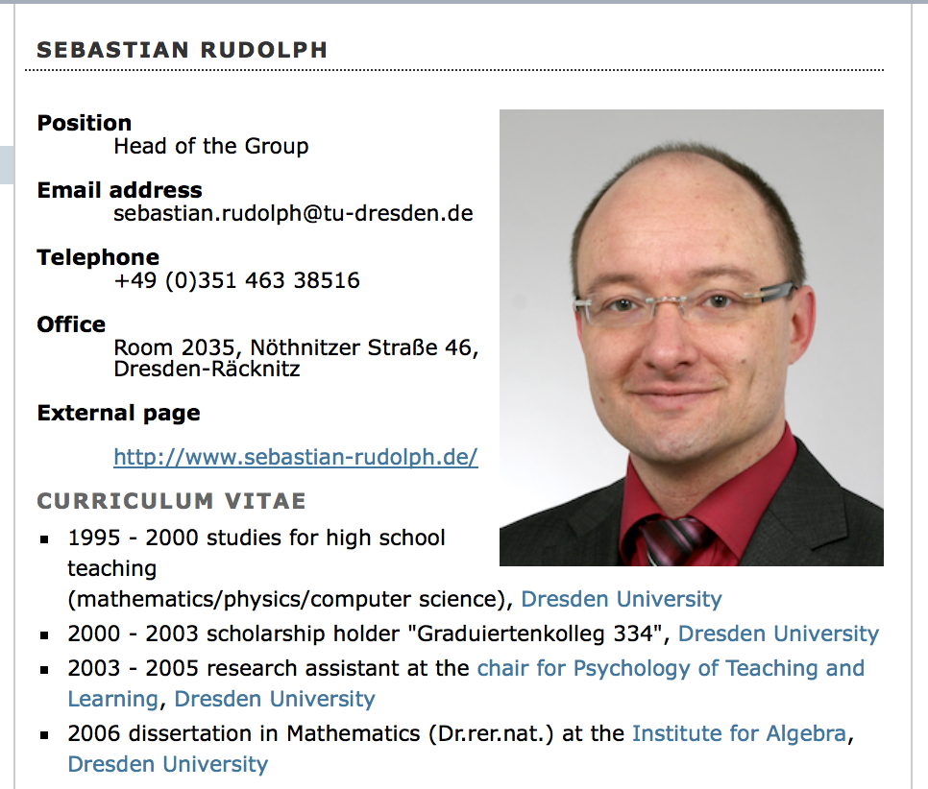
Problems of the Web of Documents
wealth of information
… targeted at human users

Slide 10
Pages with Computer-readable Layout Information
<h1 class="documentFirstHeading">Sebastian Rudolph</h1>
<div id="bodyContent" class="plain">
<img src="/content/institutes/ki/cl/people/images/Rudolph.png" width="200" alt="portrait" style="float: right;" />
<dl>
<dt>Position</dt>
<dd>Head of the Group</dd>
<dt>Email address</dt>
<dd>sebastian.rudolph@tu-dresden.de</dd>
<dt>Telephone</dt>
<dd>+49 (0)351 463 38516</dd>
<dt>Office</dt>
<dd>Room 2035, N&ouml;thnitzer Stra&szlig;e 46, Dresden-R&auml;cknitz</dd>
<dt>External page</dt>
</dl>
<dl>
<dd><a href="http://www.sebastian-rudolph.de/">http://www.sebastian-rudolph.de/</a></dd>
</dl>
<h2>Curriculum vitae</h2>
<ul>

Slide 11
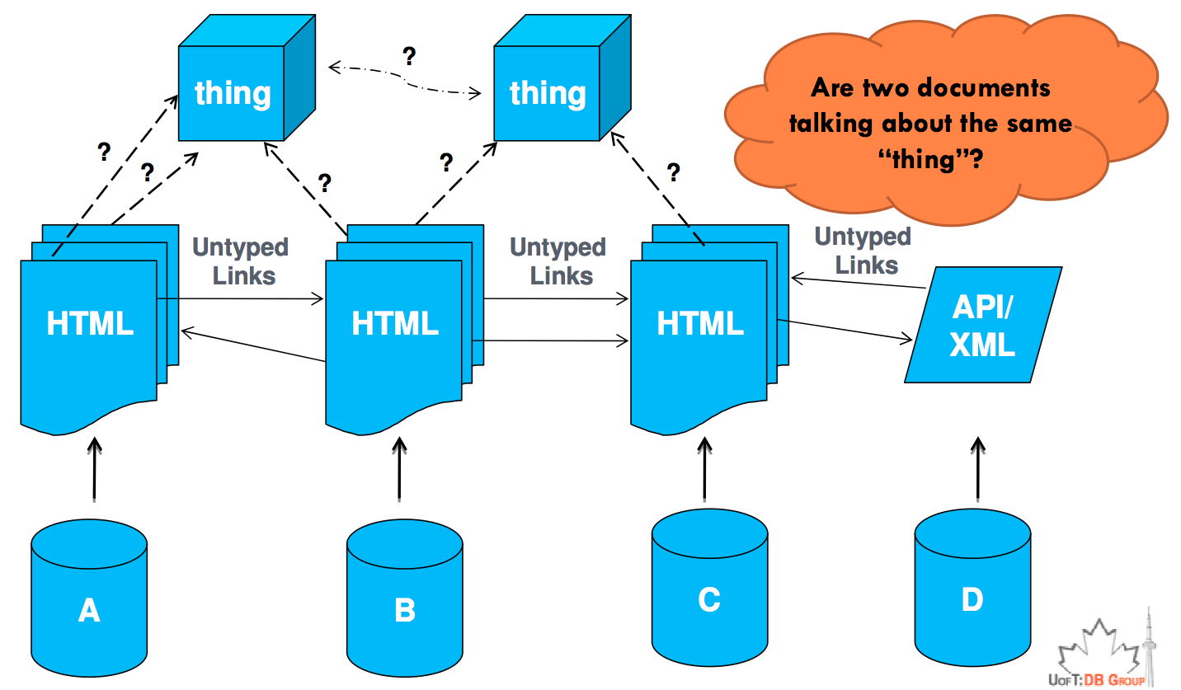
Web of Documents

Slide 12
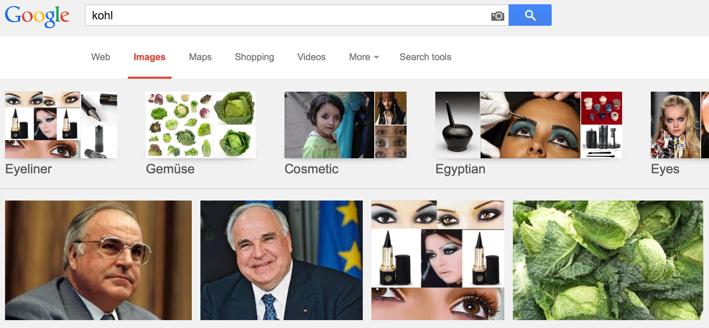
Problems of the Web of Documents
localizing information problematic
today’s search engines are good, but still keyword-based

Slide 13
Problems of the Web of Documents
How about this query:
How many romantic comedy Hollywood movies are directed by a person who is born in a city that has average temperature above 15 degrees!?
You need to:
Find reliable sources containing facts about movies (genre & director), birthplaces of famous artists/directors, average temperature of cities across the world, etc.
➔ The result: several lists of thousands of facts
Integrate all the data, join the facts that come from heterogeneous sources
Even if possible, it may take hours to answer just a single query!

Slide 14
Problems of the Web of Documents
Heterogeneity of present information on diverse levels:
character encoding (e.g. ASCII vs.Unicode)
used natural languages
positioning of information on web pages
desirable: information integration across the Web

Slide 15

Problems of the Web of Documents
implicit knowledge, i.e. many pieces of information are not provided explicitly, but follow from the combination of the given data
requires “logical thinking”
➔ automated deduction

Slide 16
Problems of the Web of Documents
Approaches toward a solution:
Ad hoc: Deployment of AI methods (most notably NLP techniques) to evaluate existing unstructured information on the Web
A priori: Structure information on the Web at authoring time in a way facilitating later automated deployment
➔ Semantic Web

Slide 17
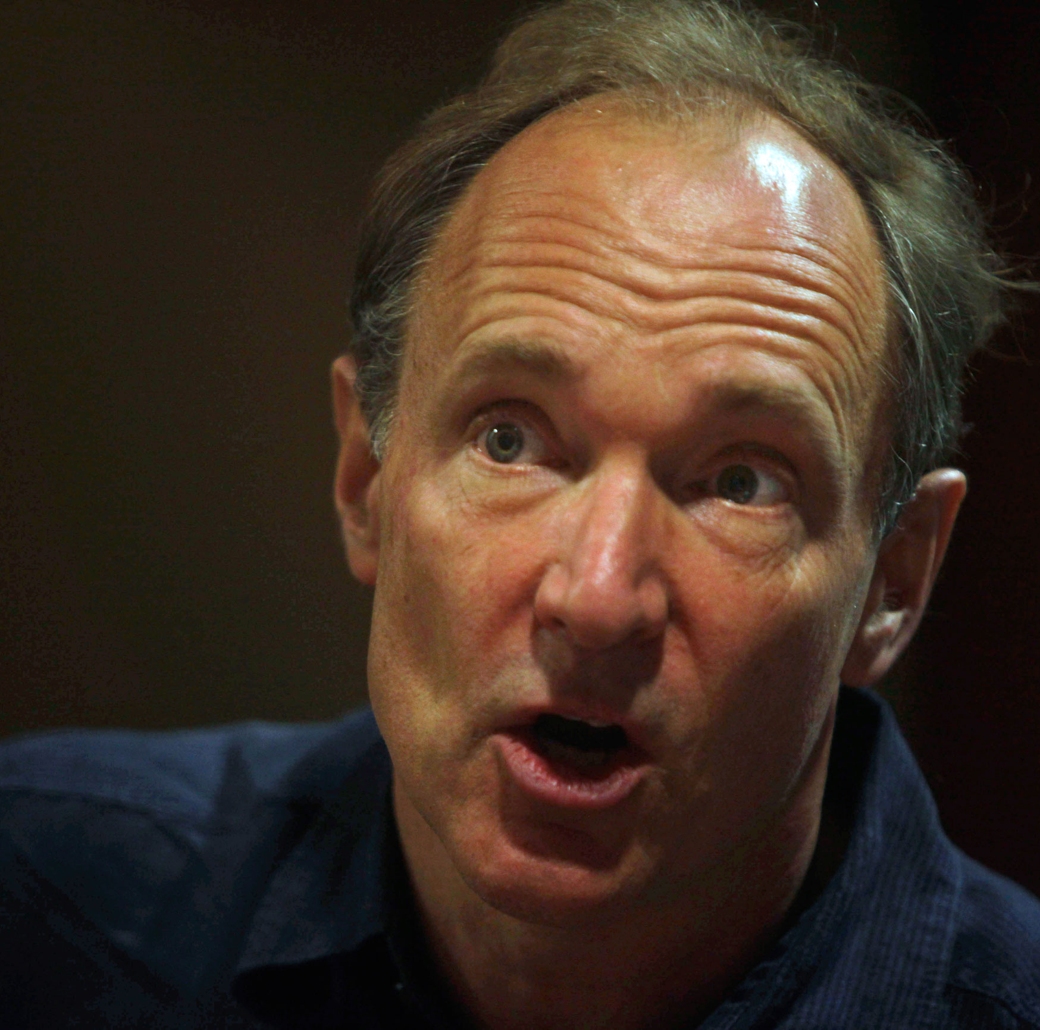
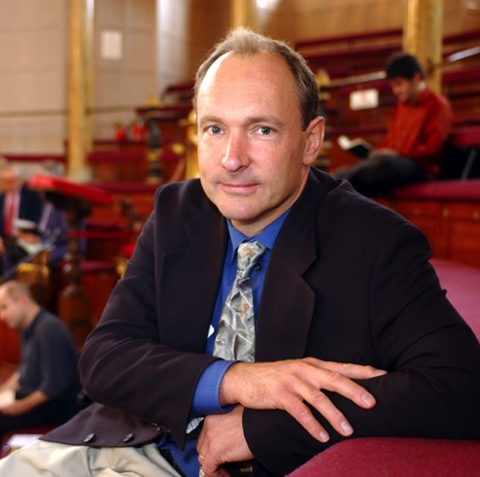
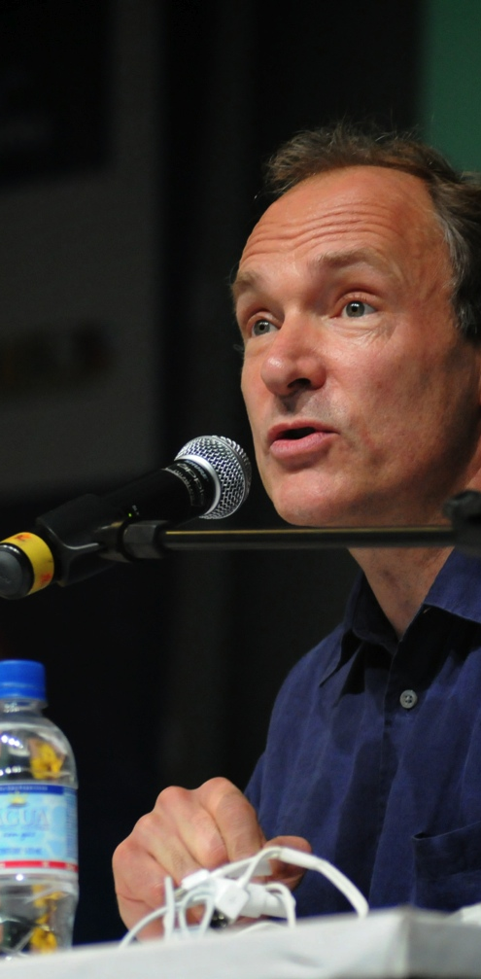
The Vision
I have a dream for the Web in which computers become capable of analyzing all the data on the Web - the content, links, and transactions between people and computers. A Semantic Web, which should make this possible, has yet to emerge, but when it does, the day-to-day mechanisms of trade, bureaucracy and our daily lives will be handled by machines talking to ma- chines. The intelligent agents people have touted for ages will finally materialize.
Berners-Lee, 1999

Slide 18
Semantic Web
Two essential prerequisites for the implementation:
open standards for describing information
clearly defined
flexible
extendable
methods for retrieving information from such descriptions

Slide 19
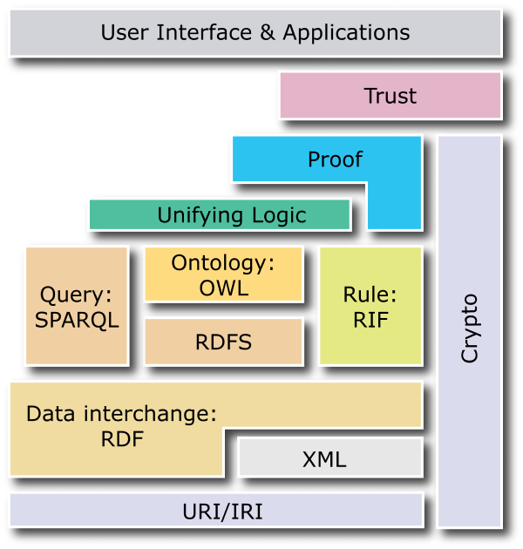
Semantic Web: Standards
1994 First public presentation of the Semantic Web idea
1998 Start of standardization of data model (RDF) and a first ontology languages (RDFS) at W3C
2000 Start of large research projects about ontologies in the US and Europe
2002 Start of standardization of a new ontology language (OWL) based on research results
2004 Finalization of the standard for data (RDF) and ontology (OWL)
2008 Standardization of a query language (SPARQL)
2009 Extension of OWL to OWL 2.0
2010 Standard Rule Interchange Format (RIF)
^{2013 SPARQL 1.1}

Slide 20
The Semantic Web Idea
Semantic Technologies

Slide 21
Not Only About the Web
The Semantic Web vision has generated technologies that are applied outside the web context including:
Retailing, supermarkets (see web pages of Best Buy)
Health care, medicine (see SNOMED ontology)
Enterprise intelligence (see solutions by Ontotext)
Research: Bio, Geo, Cultural heritage, etc. (see this week’s KRDB seminar by Alasdair Gray)
Government (“smart cities”)
Software development (“ontology-driven software develoment”)
…

Slide 22
Introduction to the Semantic Web Approach
How does the Semantic Web approach help us
merge data sets
infer new relations between data items, and
integrate new data sources?
Notes:
We will use a simplistic example to introduce the main Semantic Web concepts
We take, as an example area, data integration

Slide 23
Sketch of Data Integration with Semantic Technologies
Map the various data onto an abstract data representation ➔ Make the data independent of its internal representation …
Merge the resulting representations
Start querying the whole merged set ➔ We can answer queries that were impossible over the individual data sets

Slide 24
Data Set “A”: A Simple Book Store
Books
ID | Author | Title | Publisher | Year
ISBN0-00-651409-X | id_xyz | The Glass Palace | id_qpr | 2000
Authors
ID | Name | Home page
id_xyz | Ghosh, Amitav | http://www.amitavghosh.com
Publishers
ID | Publisher Name | City
id_qpr | Harper Collins | London

Slide 25
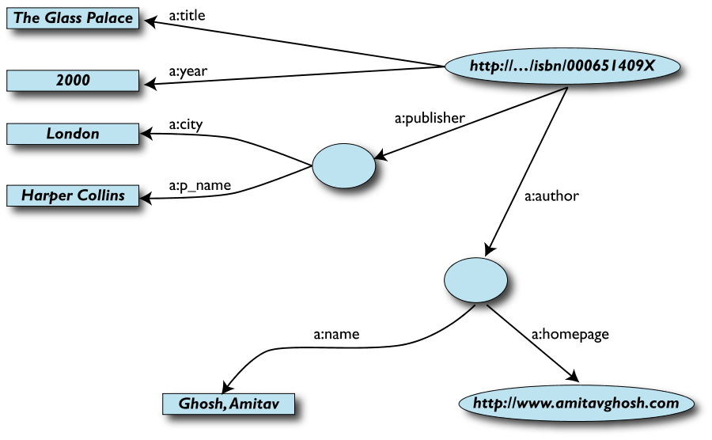
1st: Export Your Data as a set of Binary Relations (= Labeled Graph)

Slide 26
Remarks on the Data Export
Data export does not necessarily mean physical conversion of (all) the data
Relations can be virtual, generated on-the-fly at query time
via SQL “bridges”
scraping HTML pages
extracting data from Excel sheets
etc…
One can export part of the data

Slide 27
Data set “F”: Another Book Store’s Data
Notes:
This time, stored in a spreadsheet!

Slide 28
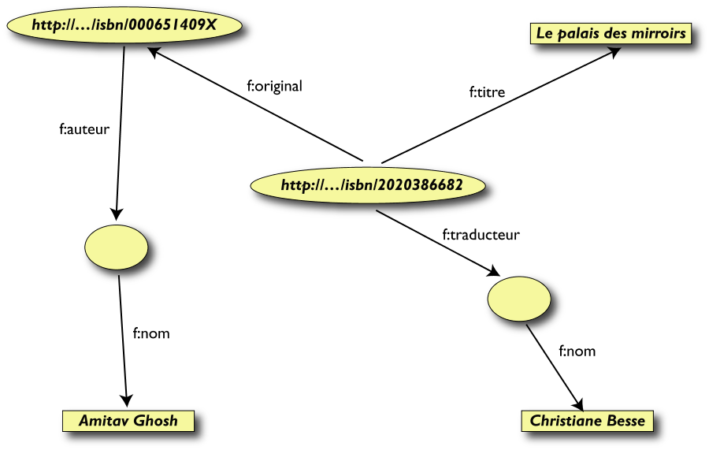
2nd: Export Your Second Set of Data

Slide 29
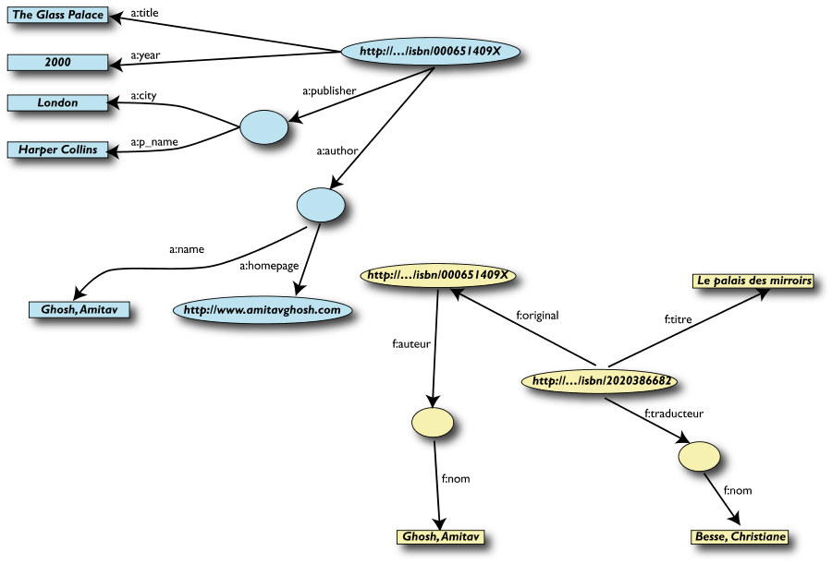
3rd: Start Merging Your Data

Slide 30
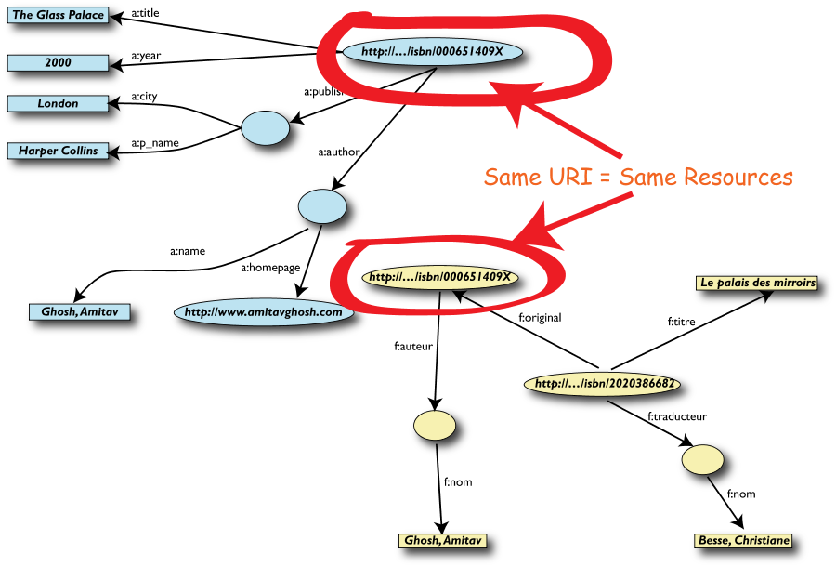
3rd: Start Merging Your Data (cont’d)

Slide 31
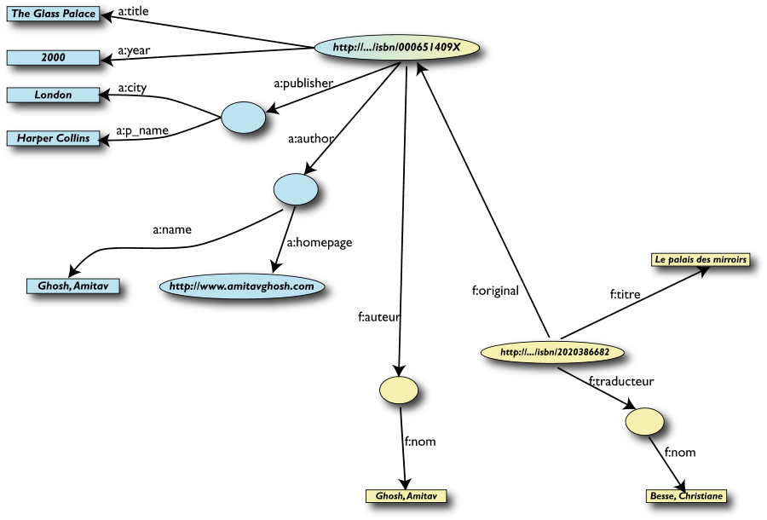
4th: Merge Identical Resources

Slide 32
Start Posing Queries…
User of data set “F” can now ask queries like:
“What is the title of the original version of Le Palais des miroirs?”
This information is not in the data set “F”…
…but can be retrieved after merging it with data set “A”!

Slide 33
5th: Query the Merged Data Set

Slide 34
However, We Can Achieve More …
We “know” that a:author and f:auteur are really the same
But our automatic merge does not know that!
Let us add some extra information to the merged data:
a:author is equivalent to f:auteur both denote a Person, a category (type) for certain resources
a:name and f:nom are equivalent to foaf:name
a person is uniquely identified by his/her name (= foaf:name)

Slide 35
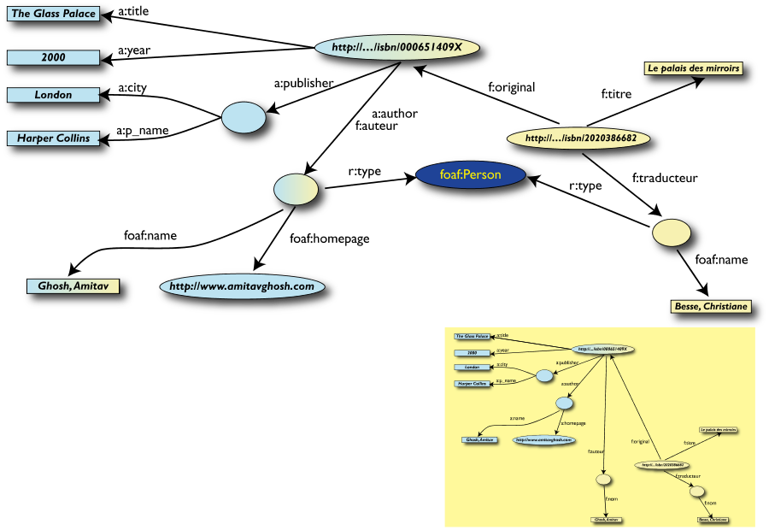
3rd Revisited: Use the Extra Knowledge

Slide 36
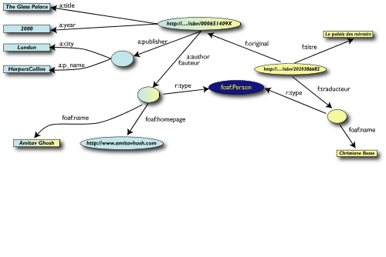
Start Making Richer Queries!
User of data set “F” can now query:
“What is the home page of the ‘auteur’ of the orignal version of Le Palais des miroirs ?”
The information is not in data set “F” nor is it in “A”…
…but was made available by:
Merging data sets “A” and “F”
Adding three “glue” statements

Slide 37
6th: Richer Queries

Slide 38
Bring in Other Data Sources
Using the fact that Amitav Ghosh is of class Person, we can combine our data with Person data from additional sources
Factual information from Wikipedia has been extracted with dedicated tools in the DBpedia project (FU Berlin, U Leipzig)
let’s combine our data with DBpedia

Slide 39
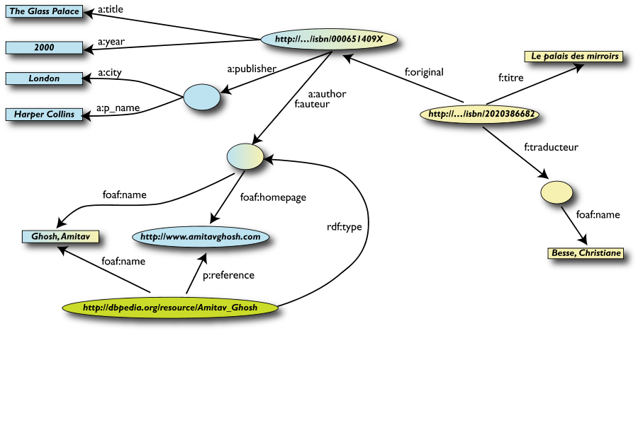
7th: Merge with DBpedia Data
owl:sameAs

Slide 40
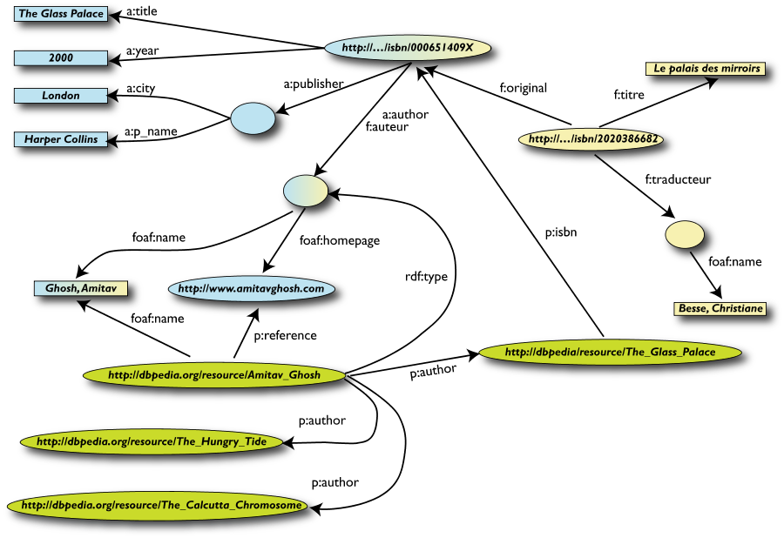
7th (cont’d): Merge with DBpedia Data
owl:sameAs

Slide 41
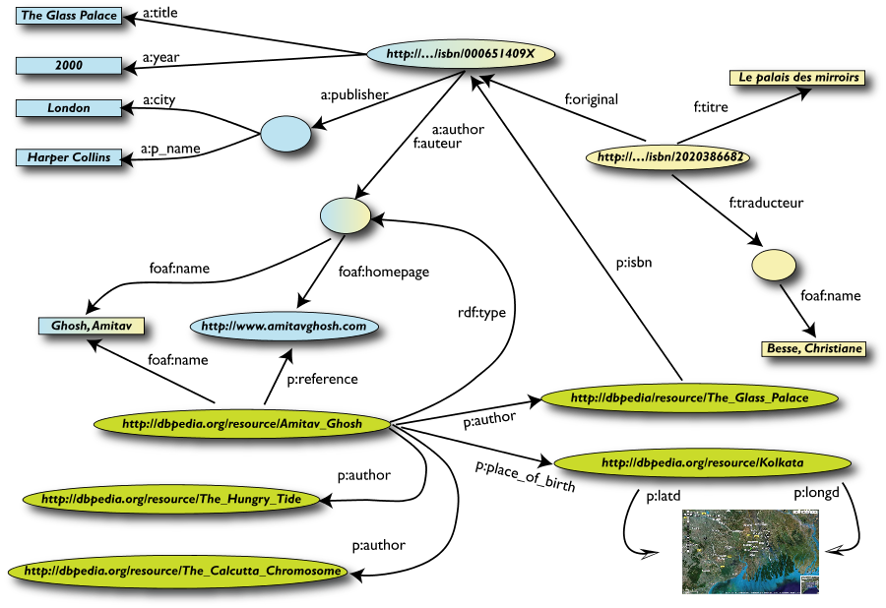
7th (cont’d): Merge with DBpedia Data
owl:sameAs

Slide 42
Rigour Makes the Difference
What happened via automatic means is done every day by Web users!
The difference: a bit of extra rigour so that machines can do this, too

Slide 43
What Did We Do?
We combined different data sets that
may be internal or somewhere on the Web
are of different formats (RDBMS, Excel spreadsheet, (X)HTML, etc)
have different names for the same relations
We could combine the data because some URIs were identical
i.e. the ISBNs in this case
We could add some simple additional information (the “glue”) to help further merge data sets by applying some simple reasoning
➔ We could find new relationships between data

Slide 44
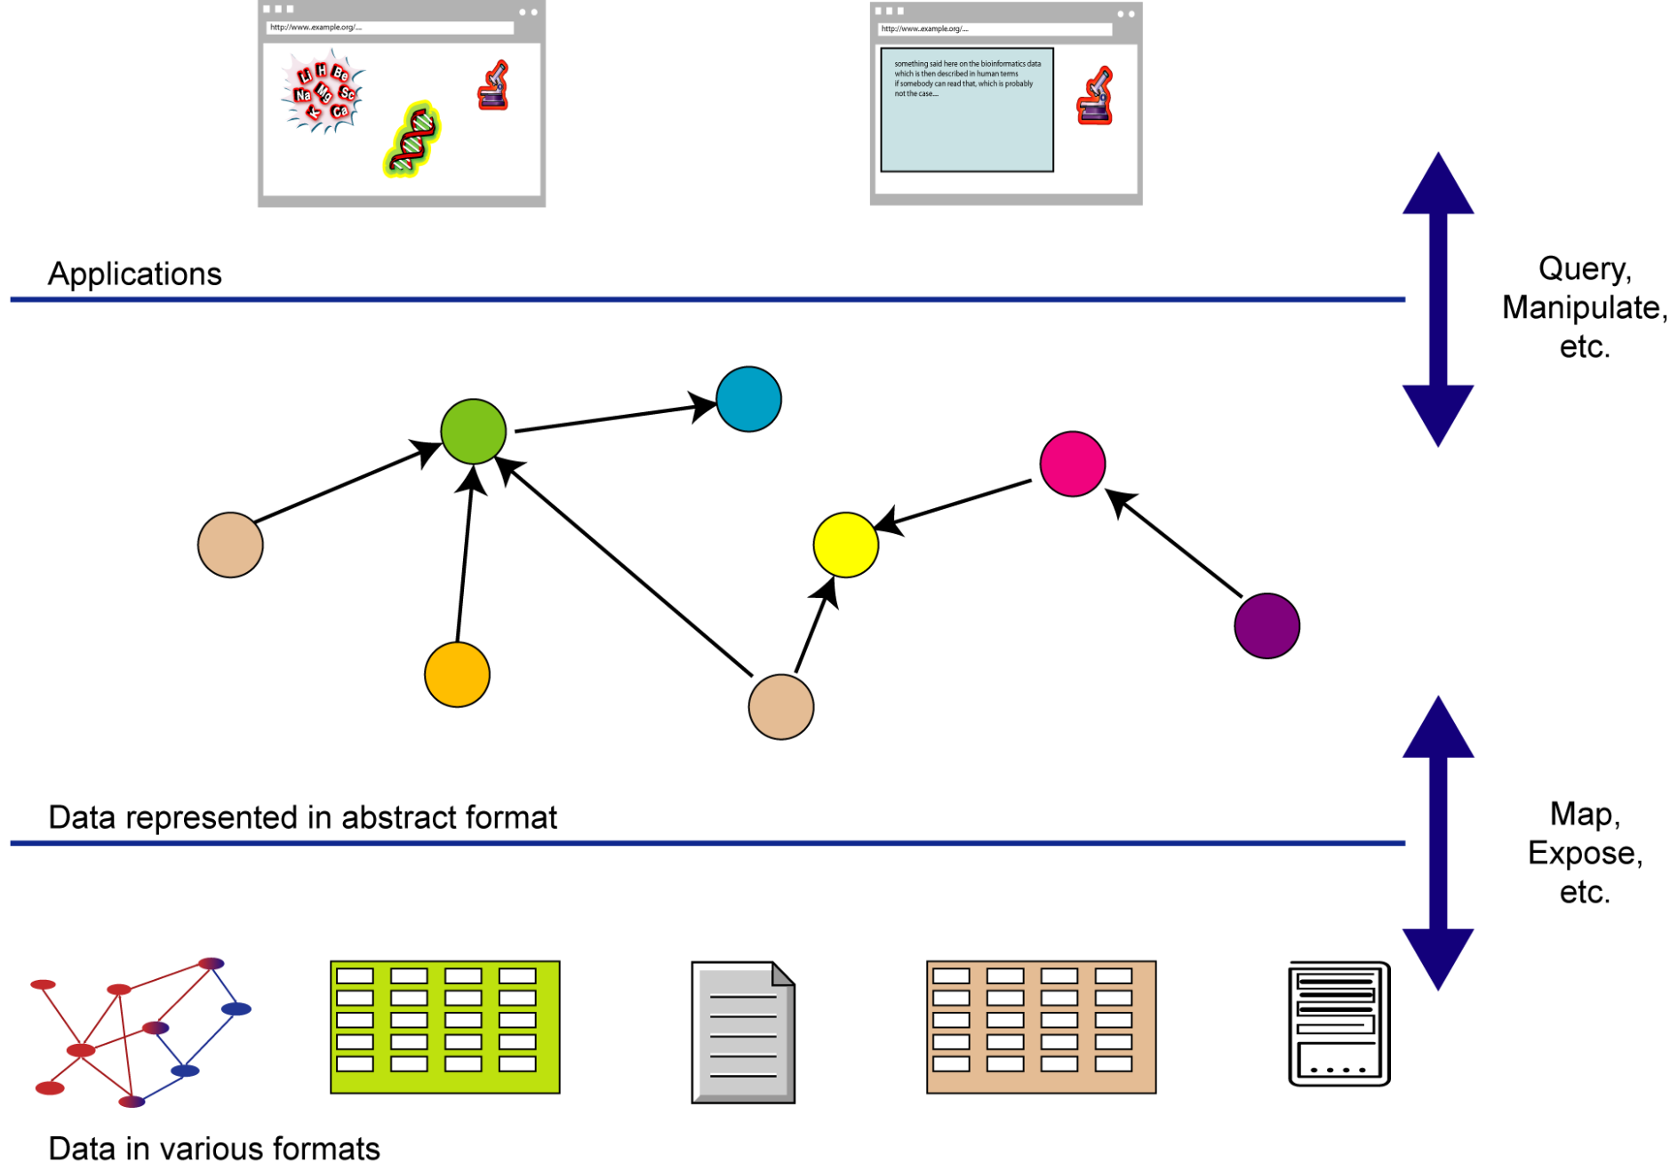
What Did We Do? (cont’d)

Slide 45
The Abstraction Pays Off Because…
…the graph representation is independent of the details of the native structures
…a change in local database schemas, HTML structures, etc. does not affect the abstract graph
“schema independence”
…new data, new connections can be added using the same data model
… the approach can be applied both at the Web level and the enterprise level

Slide 46
So where is the Semantic Web?
Semantic Web technologies make such integration possible

Slide 47
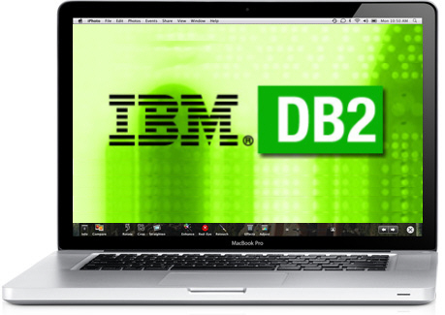

Semantic Technologies in Business
SNOMED
Oracle (Server)
IBM (DB2, Watson)
Schema.org
Good-relations
SAP
BBC
Best Buy
Startups

Slide 48
Semantic Technologies: Overview
A set of technologies and frameworks that enable semantic data management, data integration and the web of data
Resource Description Framework (RDF)
A variety of data interchange formats (e.g., RDF/XML, N3, Turtle, N-Triples)
Semantic languages such as RDF Schema (RDFS), the Web Ontology Language (OWL) and the Query language (SPARQL)
Software infrastructure (RDF/SPARQL frameworks, Triple stores, Data integrators, Query engines, Reasoners)
Publicly available connected dataset and open data initiatives (LOD)

Slide 49
Reading Material
FSWT Section 1.4
PSW Chapter 1
SWP Part I, Chapter 1

