Slide 1
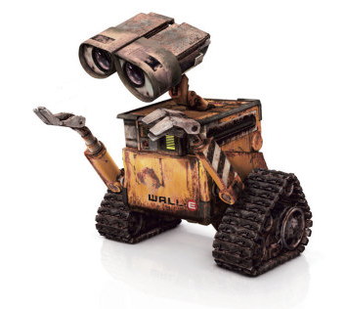
Completeness of Queries over Incomplete Databases
Werner Nutt
joint work with Marco Montali, Sergey Paramonov, Simon Razniewski, Ognjen Savkovic, Alex Tomasi, Fariz Darari
(VLDB‘11, CIKM’12, BPM‘13, ISWC‘13)
Notes:
…
Schmaleren courier-font finden!
Folienunterschriften neue Slides berücksichtigen
Voc maybe in Vocat ändern

Slide 2
Background
Incompleteness is omnipresent in data management
Null values in relational databases: Codd 1975
Representation systems: Imielinski/Lipski
1984 Focus on certain/possible answers
Query completeness over incomplete databases: little attention

Slide 3
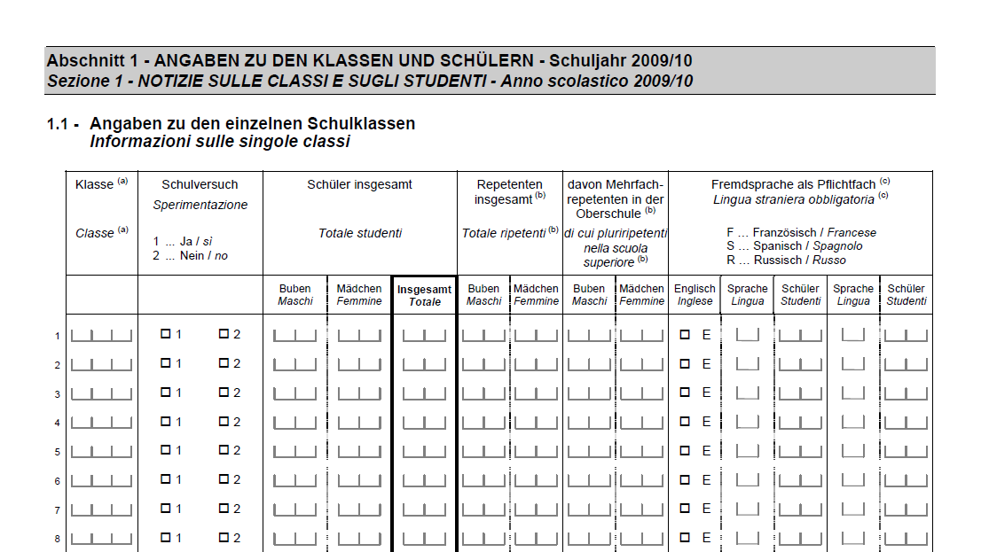
School Data Management in Bolzano
Decentrally maintained database Statistical reports
decentrally maintained database („Popcorn“)
School Statistics (ASTAT)
??
generally incomplete
require complete data
generally incomplete require complete data

Slide 4
Incompleteness in the School Data
Facts in real world
Facts in school database
result(Paul, Math, A)
result(Giulia, Math, A)
result(Paul, Math, NULL)
Missing information in the school database:
- no entry for Giulia (missing record)
- no grade for Paul (missing value)
Notes:
Say: There are two ways in which data can be incomplete, first …, second …

Slide 5
Consequence: Query Answers are Incorrect
Query Q: ”How many pupils have grade A in Math?”
In the real world: Q( ) = 2
According to available database: Q( ) = 0
→ If data is incomplete, query answers become incorrect.
result(Paul, Math, A)
result(Giulia, Math, A)
result(Paul, Math, NULL)

Slide 6
Why are Data About Pupils Incomplete?
Data have not yet been copied from the local school database to the central database
The copying procedure has been aborted
Pupils have been already registered/ classes have been formed, but pupils have not yet been entered into the database
Some schools (e.g. vocational schools) administer student grades with Popcorn, others not
School careers of immigrants are often not captured

Slide 7
But: Data are Partially Complete
Grades of students at vocational schools are complete …
Grades of students at vocational schools are complete, … after reports have been handed out
Classes at school X are complete, when the classes have been formed … and entered into Popcorn
How can we use information about partial completeness? Meta data!
Business rules
Stadium of a business process
Deadlines of business processes

Slide 8
Use Metadata to Guarantee Completeness!
... vocational schools use the information system of the province
to manage grades
Suppose, we know whether parts of a db are complete, e.g.,
“The grades from vocational schools are complete”
“The Math grades from primary schools are complete”
➔ Idea: Assess completeness of a query using completeness assertions for (parts of) tables
... primary schools took part in a survey of Math education

Slide 9
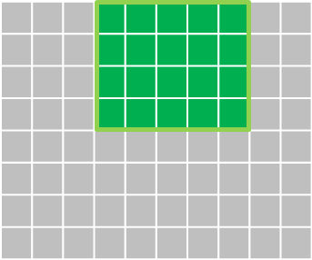
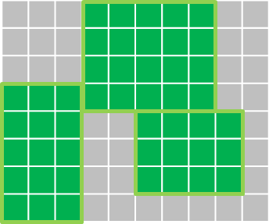
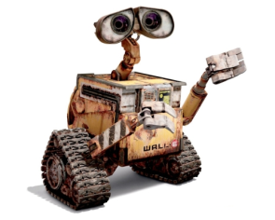
Reasoning about Query Completeness
Grades from vocational schools are complete
I want to know “How many pupils have grade A in Math?“
Can I trust the query answer?
All Math grades from primary schools are complete
Biology grades from high schools are complete
You cannot, because information about pupils from high schools could be missing
Space of possible information
Assertions about partial completeness

Slide 10
Reasoning about Query Completeness (2)
Grades from vocational schools are complete
I want to know “How many pupils at vocational schools have grade A in Math?“
Can I trust the query answer?
All Math grades from primary schools are complete
Biology grades from high schools are complete
You can, because all needed information is complete in the database
Space of possible information
Assertions about partial completeness
Notes:
Think about presentation of areas!

Slide 11
Research Questions: How can one ...
… assert completeness of parts of a possibly incomplete database?
… formalize completeness of query answers?
Grades from vocational schools are complete
I want to know “How many pupils at vocational schools have grade A in Math?“
Can I trust the query answer?
All Math grades from primary schools are complete
… implement such reasoning techniques?
… infer completeness of query answers from such assertions?
Biology grades from high schools are complete
You can, because all needed information is complete in the database
Space of possible information
Assertions about partial completeness
Notes:
Think about presentation of areas!

Slide 12
MAGIK (= Managing Incomplete Knowledge)
Ideas:
Database queries = logical formulas
Completeness meta data = logical formulas
Analysis = logical inference
Implementation: using software for logical inferences
Interface Layer
Data Layer
Input
Output
Evaluate SQL Queries
(database mode)
Schema constraints
Query Results
TC-statements
Gen. and Spec.
SQL queries
Query Completeness
Partially Complete Database
Reasoning Layer
Read Database Schema
(database mode)
Program Business Logic
Read/Write Virtual Schema
(virtual mode)
Completeness Reasoner
Hibernate Store/Load
TCs and Queries
TuProlog
DLV Engine
Meta-information Storage

Slide 13
Running Example: Schema
result(name, subject, grade)
pupil(name, age, schoolName, schoolType)

Slide 14
Notation: Databases
Database instances are sets of ground atoms, e.g.,
D = { result(Paul, Math, NULL), result(Giulia, Math, A), pupil(Paul, 17, Verdi, Voc) },
possibly containing NULLs.

Slide 15
Notation: Conjunctive Queries
A single block SQL queries, possibly with DISTINCT,
SELECT r.grade FROM result r, pupil p WHERE r.name = p.name AND r.subject = ’Math’ AND p.age <= 11
is expressed as a conjunctive query (CQ), using a Datalog rule:
Q(g) :- result(n, Math, g), pupil(n, a, sn, st), a ≤ 11

Slide 16
Notation: Conjunctive Queries (2)
Q(x) :- L(x, y), M
L(x, y) conjunction of relational atoms
M conjunction of comparisons
x vector of distinguished (= output) variables
y vector of non-distinguished (= existential) variables
Query answers (under set semantics):
Q(D) = αx | αL ⊆ D, α╞ M}
Bag semantics: each α contributes a copy of αx
As a default,
we assume set semantics

Slide 17
Possible Completeness Statements
“We get complete answers to the following queries:
Which pupils have grade A in Math?
Which pupils from vocational schools have grade A in Math? Query Completeness Statements
“The database contains
all subjects and grades of pupils from vocational schools
all subjects studied by pupils from vocational schools “
Table Completeness Statements

Slide 18
Formalization: Incomplete Database
[Motro 1989]
When talking about incompleteness, we need a complete reference
An incomplete database D is a pair of
an ideal database D^{i} and
an available database Dª
D = (D^{i}, Dª)
such that
for each record in Dª there is a “more informative” record in D^{i}
For databases w/o Nulls,
this means
Dª ⊆ D^{i}
Notes:
Say: Formalizes the intuition

Slide 19
Example: An Incomplete Database
D^{i}
Dª
result(Paul, Math, A)
result(Giulia, Math, A)
result(Maria, Math, A)
pupil(Paul, 17, Hofer, Voc)
pupil(Giulia, 15, Verdi, Sec)
result(Paul, Math, A)
result(Giulia, Math, NULL)
pupil(Paul, 17, Hofer, Voc)
less informative than
Notes:
Simplify it??

Slide 20
Formalization: Query Completeness
[Motro 1989]
Query Q
“The answer to Q is complete”
Notation: Compl(Q)
Semantics:
(D^{i}, Dª) ╞ Compl(Q) iff Q(D^{i}) = Q(Dª)
To be precise, we have to distinguish between set and bag semantics

Slide 21
Example: Query Completeness
Q_{MathA}(n) :- result(n, Math, A)
Q_{MathA}(D^{i}) = {Paul, Giulia, Maria} Q_{MathA}(Dª) = {Paul}
Q_{MathA} is not complete over (D^{i}, Dª)
D^{i}
Dª
result(Paul, Math, A)
result(Giulia, Math, A)
result(Maria, Math, A)
pupil(Paul, 17, Hofer, Voc)
pupil(Giulia, 15, Verdi, Sec)
result(Paul, Math, A)
result(Giulia, Math, NULL)
pupil(Paul, 17, Hofer, Voc)
Notes:
Simplify it??

Slide 22
Example: Query Completeness (2)
Q_{MathAVoc}(n) :- result(n, Math, A), pupil(n, a, sn, Voc)
Q_{MathAVoc}(D^{i}) = {Paul} Q_{MathAVoc}(Dª) = {Paul}
D^{i}
Dª
Q_{MathAVoc} is complete over (D^{i}, Dª)
result(Paul, Math, A)
result(Giulia, Math, A)
result(Maria, Math, A)
pupil(Paul, 17, Hofer, Voc)
pupil(Giulia, 15, Verdi, Sec)
result(Paul, Math, A)
result(Giulia, Math, NULL)
pupil(Paul, 17, Hofer, Voc)
Notes:
Simplify it??

Slide 23
Table Completeness Statements: Idea
This is a full tuple-generating dependency (TGD)
“The table result contains all results of pupils from vocational schools“
means
“If (n,s,g) is a result record according to the ideal db, and (n, a, sn, Voc) is a pupil record in the ideal db,
then (n,s,g) is in the result table of the available db”
This can be expressed by the rule
result^{i}(n,s,g), pupil^{i} (n, a, sn, Voc) → resultª (n, s, g)
We write this table completeness statement as
Compl( result(n, s, g) ; pupil(n, a, s, Voc))
Idea: an incomplete db satisfies the statement iff it satisfies the rule

Slide 24
Table Completeness Statements [Halevy 96]
G may contain both, relational and built-in atoms
A table completeness (TC) statement for a relation R is an expression
Compl(R(s₁,…, s_{n}) ; G)
consisting of
an R-atom R(s₁,…, s_{n})
a condition G such that R(s₁,…, s_{n}), G is safe.
The TC-statement C = Compl(R(s₁,…, s_{n}) ; G) can be seen as a rule
r_{C} = R^{i} (s₁,…, s_{n}), G^{i} → Rª (s₁,…, s_{n})
Semantics: (D^{i}, Dª) ╞ C iff (D^{i}, Dª) ╞ r_{C}

Slide 25
Example: TC Statement Satisfaction
result^{i}(n, s, g), pupil^{i} (n, a, sn, Voc) → resultª (n, s, g)
holds over (D^{i}, Dª)
because result(Paul, Math, A) is in Dª
D^{i}
Dª
result(Paul, Math, A)
result(Giulia, Math, A)
result(Maria, Math, A)
pupil(Paul, 17, Hofer, Voc)
pupil(Giulia, 15, Verdi, Sec)
result(Paul, Math, A)
result(Giulia, Math, NULL)
pupil(Paul, 17,Hofer, Voc)
Notes:
Simplify it??

Slide 26
The TC-QC Reasoning Problem
I want to know “How many pupils at vocational schools have taken Math?“
Can I trust the query answer?
Grades from vocational schools are complete
Set of table completeness statements C
Query Q
All Math grades from primary schools are complete
Biology grades from high schools are complete
Space of possible information
Assertions about partial completeness
C ╞ Compl(Q) ?

Slide 27
Reasoning: The Principle
“Which pupils at vocational schools had an A in Math?“
Q_{MathAVoc}(n) :- result(n, Math, A), pupil(n, sn, Voc)
1. Assume Q_{MathAVoc} returns n′ over D^{i}
2. See which facts must be in D^{i}
result(n‘, Math, g‘) pupil(n‘, sn‘, Voc)

Slide 28
Reasoning: The Principle (2)
3. Use table completeness to derive facts in Dª
“All results of pupils at vocational schools are available“
result^{i}(n, s, g), pupil^{i} (n, sn, Voc) → resultª (n, s, g)
“All pupils are available“
pupil^{i} (n, sn, st) → pupilª (n, sn, st)
D^{i}
Dª
result(n‘, Math, g‘)
pupil (n‘, sn‘, Voc)
result(n‘, Math, g‘)
pupil (n‘, sn‘, Voc)
Notes:
Das zweite Statement wurde vorher nie eingeführt

Slide 29
Reasoning: The Principle (3)
4. Query the available database “Pupils at vocational schools with an A in Math“
Q_{MathAVoc} (Dª) = {n'} → n' is also in Q(Dª)
Conclusion: Q_{MathAVoc} is complete given the table completeness statements
Dª
result(n‘, Math, g‘)
pupil (n‘, sn‘, Voc)
Notes:
Put the query here again

Slide 30
TC-Transformation
To C= Compl(R(s) ; G) we associate the query
Q_{C}(s) :- R(s) , G
and the transformation on db instances
T_{C}(D) :=  R(t) | t ∈ Q_{C}(D) }
For a set C of TC statements we define the transformation
T_{C}(D) := ∪_{C ∈ C} T_{C}(D)

Slide 31
TC-Transformations: Properties
(D, T_{C}(D)) is an incomplete database
(D, T_{C}(D)) ╞ C
(D^{i}, Dª) ╞ C iff T_{C}(D^{i}) ⊆ Dª
In other words:
(D, T_{C}(D)) is the least incomplete database
with ideal db D
that satisfies C

Slide 32
TC-QC Reasoning: Relational Case
variables x, y considered as
constants x′, y′
Let
C set of relational TC statements
Q(x) :- L relational query
L′ := frozen version of L
Theorem:
C ╞ Compl(Q) iff x′ ∈ Q(T_{C}(L′))
What if C or Q contain comparisons?

Slide 33
Example: TC-QC with Comparisons
Query: Q_{pupil}(n) :- pupil(n, a, sn, st)
C =  C_{≤10} : pupil^{i}(n, a, sn, st) , a ≤ 10 → pupilª(n, a, sn, st)
C_{>10} : pupil^{i}(n, a, sn, st) , a > 10 → pupilª(n, a, sn, st) }
How can we chase L′ = { pupil(n′, a′, sn′, st′) } with C_{≤10} , C_{>10} ?
Idea: Case analysis!
Substitute “representative values” for a′ < 10, a′ = 10, a′ > 10
Substitution yields: [a′/9]L′ = { pupil(n′, 9, sn′, st′) }
to which we can apply C_{≤10 …}
We retrieve n′ in all 3 cases
The cases cover all possibilities
→ Q is complete wrt C

Slide 34
TC-QC Reasoning with Comparisons
Let
C set of TC statements with comparisons
Q(x) :- L, M
Γ set of representative value substitutions for C, Q
Theorem: The following are equivalent
C ╞ Compl(Q)
γx′ ∈ Q(T_{C}(γL′)) for all γ ∈ Γ

Slide 35
Set Semantics vs. Bag Semantics
Q(x) :- L query
(D^{i}, Dª) ╞ Compl_{set}(Q)
iff every answer of Q over D^{i} is returned over Dª, too
iff αL ⊆ D^{i} ⇒ ex. β s.th. βL ⊆ Dª and βx = αx
(D^{i}, Dª) ╞ Compl_{bag}(Q)
iff every answer of Q over D^{i} is returned over Dª the same number of times
iff αL ⊆ D^{i} ⇒ αL ⊆ Dª
“no assignments get lost”

Slide 36
TC-QC Reasoning for Bag Semantics
Let
C set of TC statements with comparisons
Q(x) :- L, M
Γ set of representative value substitutions for C, Q
Theorem:
C ╞ Compl_{bag}(Q) iff γL′ ⊆ T_{C}(γL′) for all γ ∈ Γ
Corollary: If C has no comparisons, then:
C ╞ Compl_{bag}(Q) iff L′ ⊆ T_{C}(L′)

Slide 37
Complexity
Classes of conjunctive queries:
CQ: Conjunctive queries with comparisons over dense orders
RQ: Relational conjunctive queries (i.e., without comparisons)
LCQ: Linear conjunctive queries (i.e., without self-joins)
LRQ: Linear relational conjunctive queries

Slide 38
TC-QC_{bag} - Complexity
 |  | Query Language
 |  | LRQ | LCQ | RQ | CQ
TC Statement Language | LRQ | in PTIME | in PTIME | NP | NP
 | RQ | in PTIME | in PTIME | NP | NP
 | LCQ | coNP | coNP | Π^{P}₂ | Π^{P}₂
 | CQ | coNP | coNP | Π^{P}₂ | Π^{P}₂
Note, the axes are asymmetric:
NP appears with repeated relation symbols in the query
coNP appears with comparisons in the TC statements
Notes:
coNP scheint neu zu sein, Pi^P_2-Resultate sind alle neu bis auf CQ-CQ (überprüft bei v. d. Meyden)

Slide 39
TC-QC_{set} - Complexity
 |  | Query Language
 |  | LRQ | LCQ | RQ | CQ
TC Statement Language | LRQ | in PTIME | in PTIME | NP | Π^{P}₂
 | RQ | in PTIME | in PTIME | NP | Π^{P}₂
 | LCQ | coNP | coNP | Π^{P}₂ | Π^{P}₂
 | CQ | coNP | coNP | Π^{P}₂ | Π^{P}₂
Intuition: the query has to be contained in the TC-statements . . . . . . but that does not explain it all
Notes:
coNP scheint neu zu sein, Pi^P_2-Resultate sind alle neu bis auf CQ-CQ (überprüft bei v. d. Meyden)

Slide 40
How Can One Implement Completeness Reasoning?
Idea: Map reasoning tasks to a generic reasoner
Candidate reasoners:
SMT (SAT modulo theories) solvers ?
encoding may be of exp. size for Π^{P}₂ problems
Disjunctive Logic Programming with Answer Set Semantics ?
can express all Π^{P}₂ problems
demo implementation for
conjunctive queries
finite domain constraints
keys and (acyclic) foreign keys

Slide 41
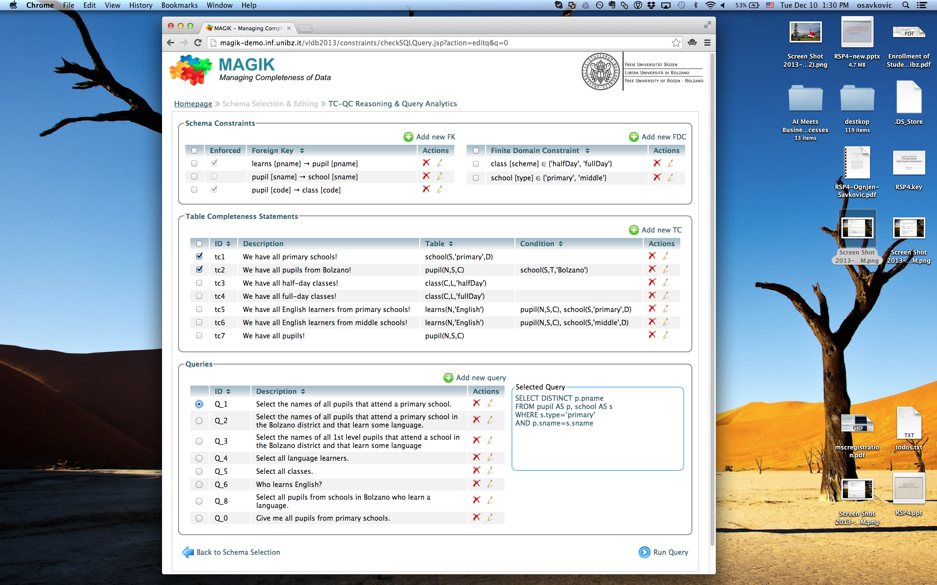
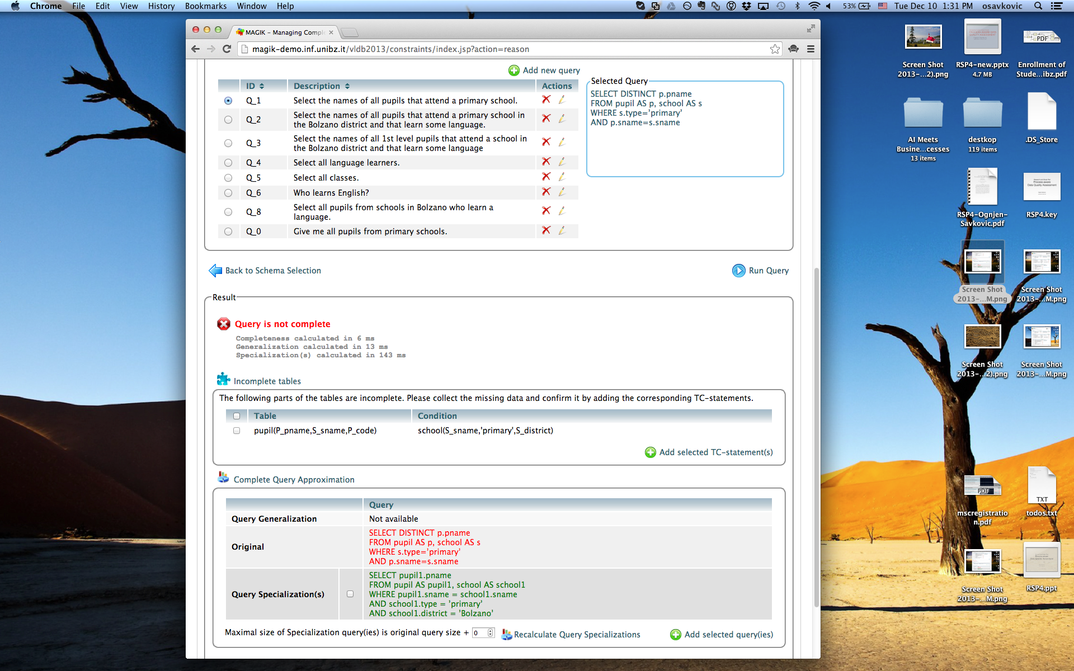
Notes:
- 2 demos
- submitted under review

Slide 42
Completeness on the Semantic Web

Slide 43
DBPedia Misses Some Facts …

Slide 44
IMDB Has Completeness Guarantees

Slide 45
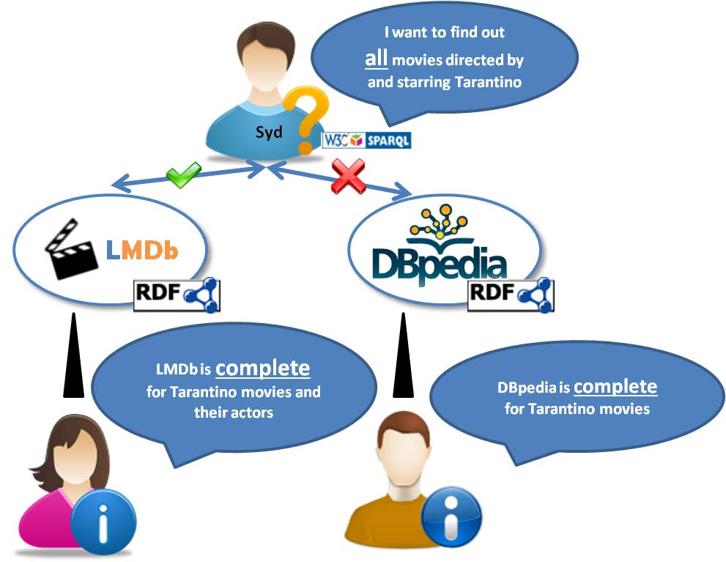
If Completeness Info Were Available in RDF …

Slide 46
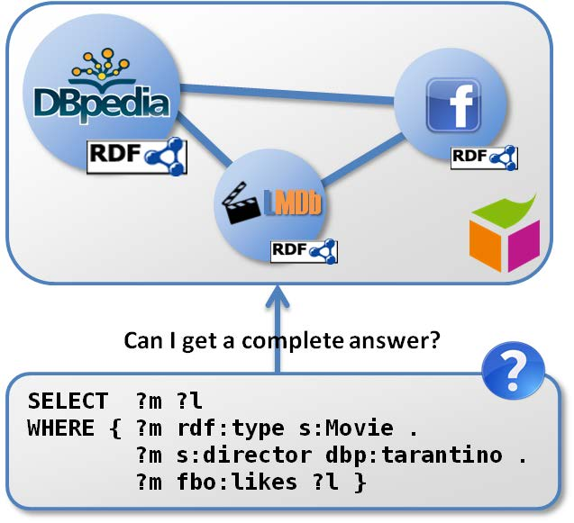
Federated Framework

Slide 47
Completeness of SPARQL Queries over RDF Sources
Completeness statements in RDF
Reasoning algorithms for queries with
DISTINCT
OPT
over RDFS sources
Generation of queries with SERVICE calls over federated sources
Prototypical implementation using Apache Jena
http://rdfcorner.wordpress.com

Slide 48
Verifying Query Completenessover Processes
Data often created following processes
Many processes are executed only partially formal (pen & paper, email, phone, …)
➔ Valid information may be stored in databases with delays
➔Database content is of questionable completeness

Slide 49
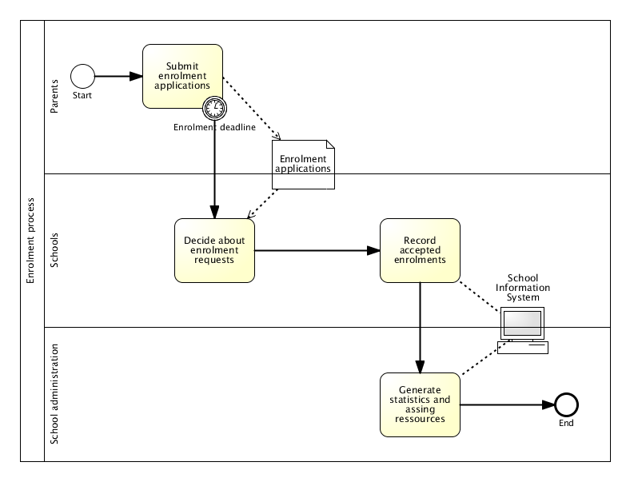
Enrolment Process in a School
Database query: How many pupils?
0
Is that correct?
Database query:
How many pupils?
137
Is that correct?
49

Slide 50
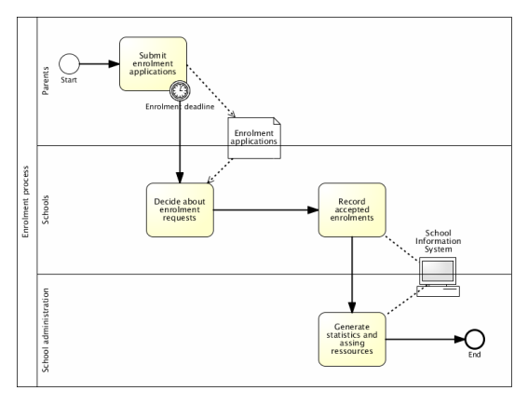
Observation
At some points, new facts in the real world have not yet been stored ➔ queries may give wrong answers
At other points, all facts that hold in the real world have been stored ➔ queries give correct answers

Slide 51
Real-world and Copy Effects
Copy effect: Copies the new enrolments into the school database
Real-world effect: Generates enrolments
Real-world effect: pupil^{rw}(n, s) $⇜$ request^{rw}(n, s)
Copy effect: pupil^{rw}(n, s) → pupil^{is}(n, s)

Slide 52
Transition Systems for Process Instances
Copy effect: Copies the new enrolments into the school database
Real-world effect: Generates enrolments

Slide 53
Transition Systems for Process Instances
Two concurrent process instances:
Middle School A
High School B
s₃
Decide enrolments
Record enrolments
s₁
s₆
Record enrolments
Record enrolments
Decide enrolments
Decide enrolments
s₄
s₈
s₀
Record enrolments
Record enrolments
Decide enrolments
Decide enrolments
s₇
s₂
Record enrolments
Decide enrolments
s₅

Slide 54
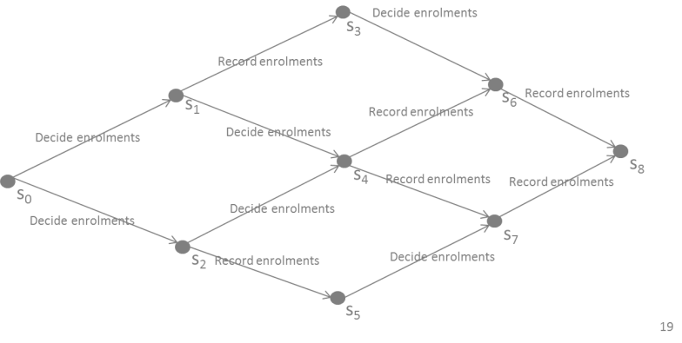
Completeness Verification
Given
Process description
State S
Query Q
Question
Is it safe to pose the query Q in state S against the information system database?

Slide 55
Verification: Example Revisited
How many middle school pupils?
How many high school pupils?
Middle School A
High School B
s₃
Decide enrolments
Record enrolments
s₁
s₆
Record enrolments
Record enrolments
Decide enrolments
Decide enrolments
s₄
s₈
s₀
Record enrolments
Record enrolments
Decide enrolments
Decide enrolments
s₇
s₂
Record enrolments
Decide enrolments
s₅

Slide 56
Possible Applications
Annotation of statistics and KPI with completeness information
Process mining (trace analysis) - to validate whether queries over traces return the real state of the process
Auditing – to verify whether the information about the real-world is properly stored

Slide 57
Conclusion
Framework for statements about completeness of
query answers
(projections of) parts of db tables
Complexity of TC-QC Reasoning
Implementation based on DLV answer set programming engine
Application to
Semantic Web
Business Processes

Slide 58
Questions?

